Slide 1
Social Media
Tomás Dodds | Leiden

Slide 2
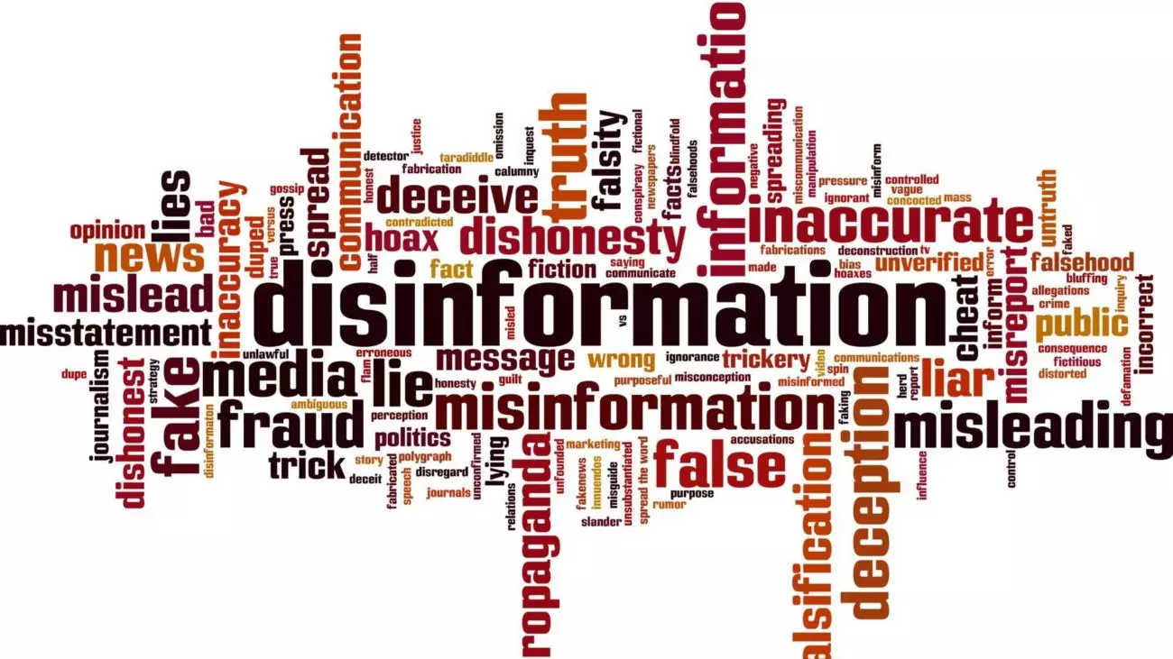
Today – Key
The business of publishing disinformation is more profitable than ever.

Slide 3
How Google’s Ad Business Funds Disinformation Around the World
Google is funnelling revenue to some of the web’s most prolific purveyors of false information in Europe, Latin America and Africa.
How Google placed ads from major brands on global websites that spread false claims on such topics as vaccines, COVID-19, climate change and elections.
The analysis found that Google placed ads on 41% of roughly 800 active online articles rated by members of the Poynter Institute’s International Fact-Checking Network as publishing false claims about COVID-19.
The resulting ad revenue is potentially worth millions of dollars to the people and groups running these and other unreliable sites — while also making money for Google.
Notes:
-A study published on October 29
-ProPublica – US Based non-profit organizations that does investigative journalism
-ProPublica found that Google still places adds on Bosnia and Herzegovina, Brazil, as well as France, Germany, Spain, and the Netherlands. - English

Slide 4
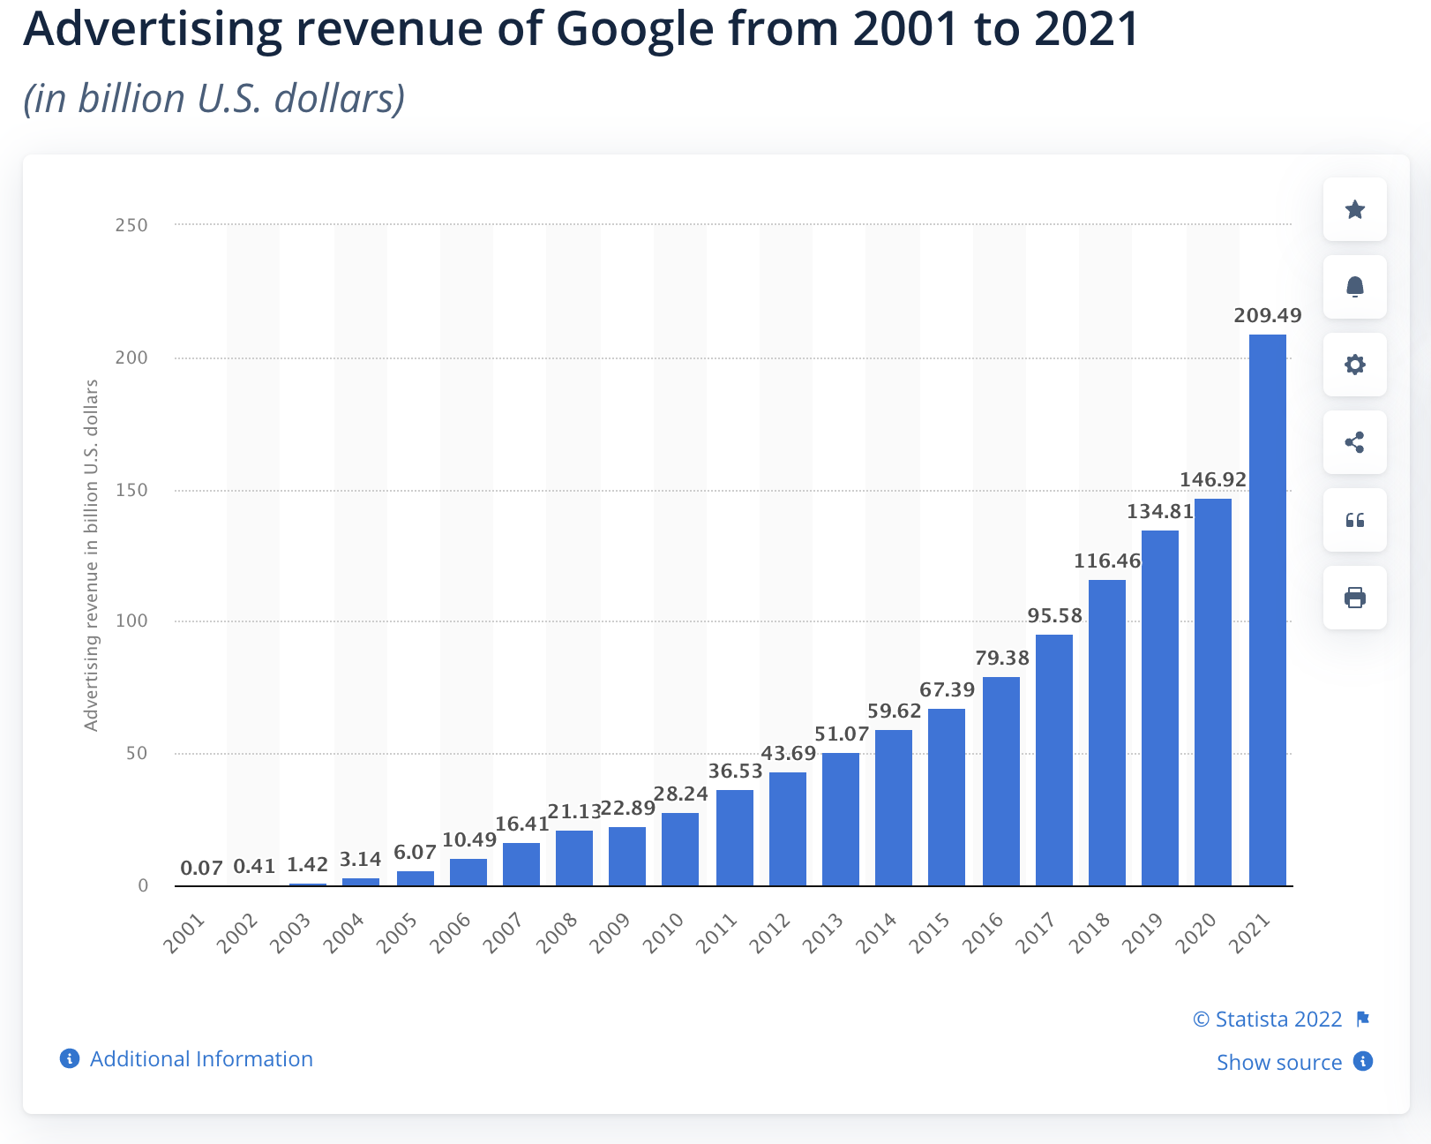
How Google’s Ad Business Funds Disinformation Around the World
Notes:
-Google is the world’s biggest digital advertising business. Last year it generated a record $257 billion in revenue. 31 of which comes from adds on websites.
-Publishers in the network receive 68% of the money spent on each ad placed on their site.
-Advertisers can expect to pay: $2.32 per click on Google Ads Search. $0.67 per click on Google Ads Display.

Slide 5
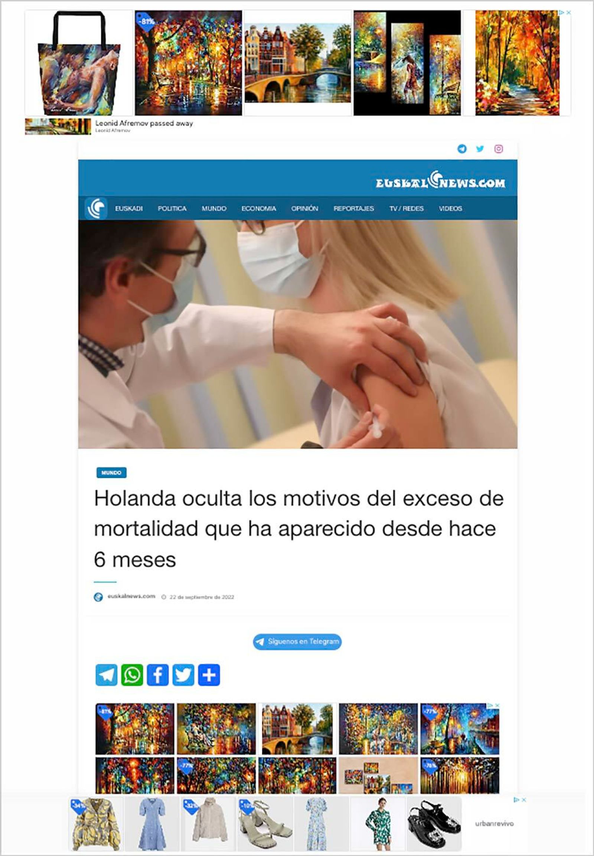
Notes:
- A EuskalNews story with Google ads that falsely linked excess death figures in the Netherlands to vaccines.

Slide 6
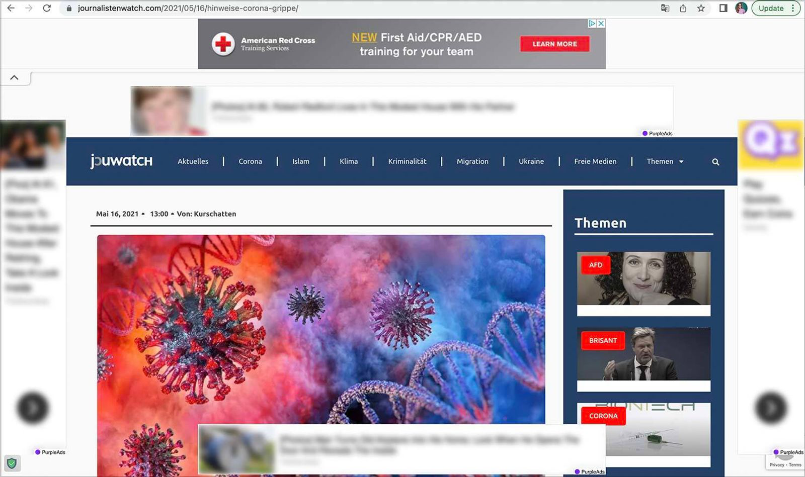
Notes:
-An ad for the American Red Cross was placed on a Journalistenwatch article that claimed COVID-19 was like the flu. Image has been blurred by ProPublica to conceal other ads on the page. – Germany.

Slide 7
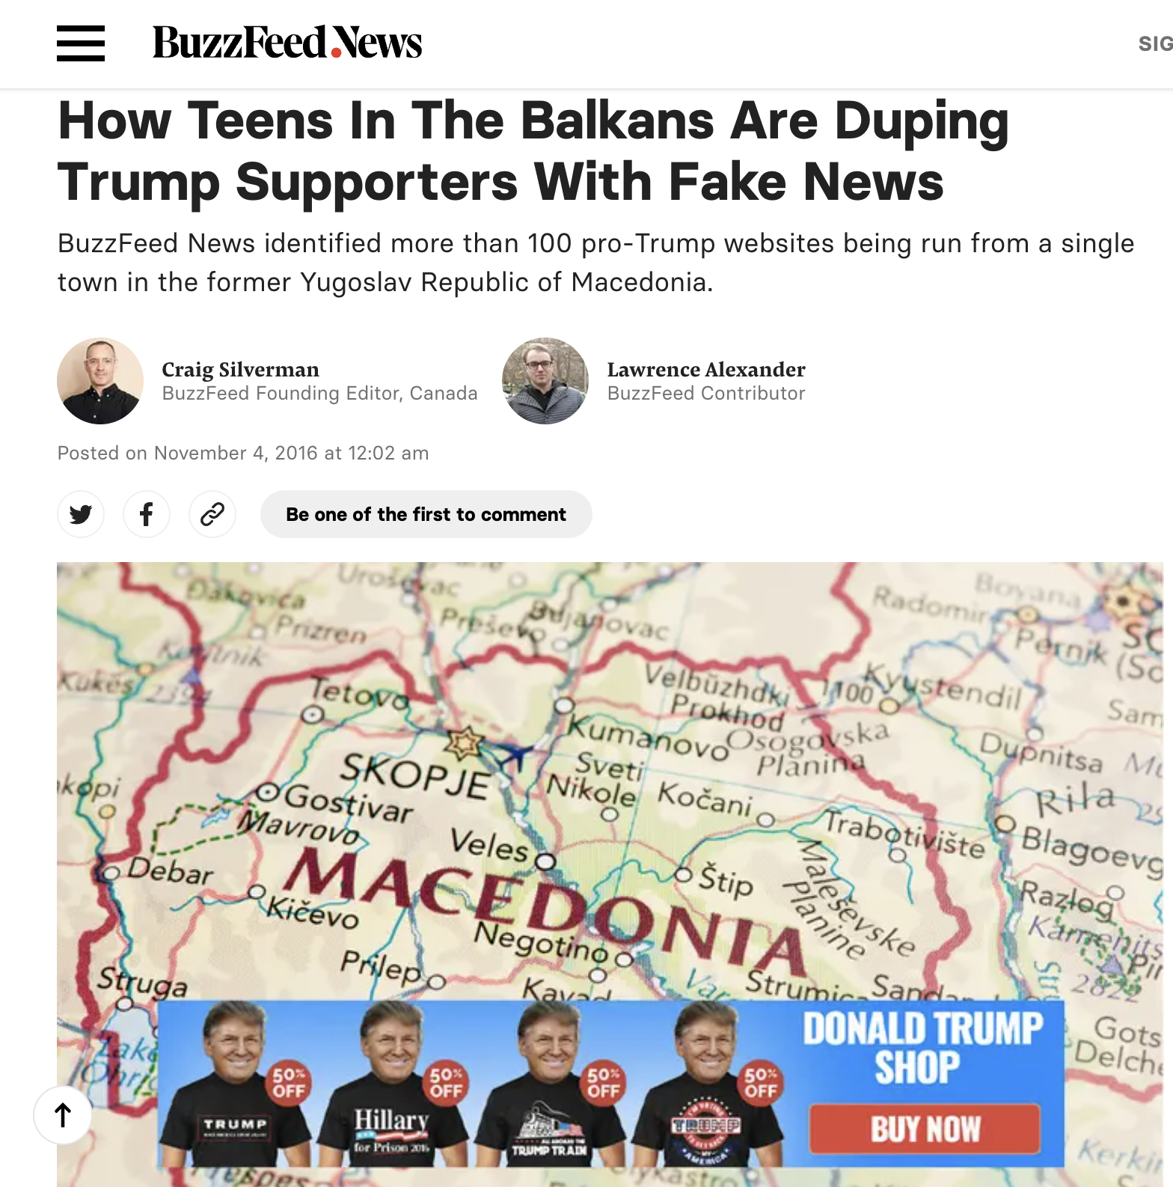
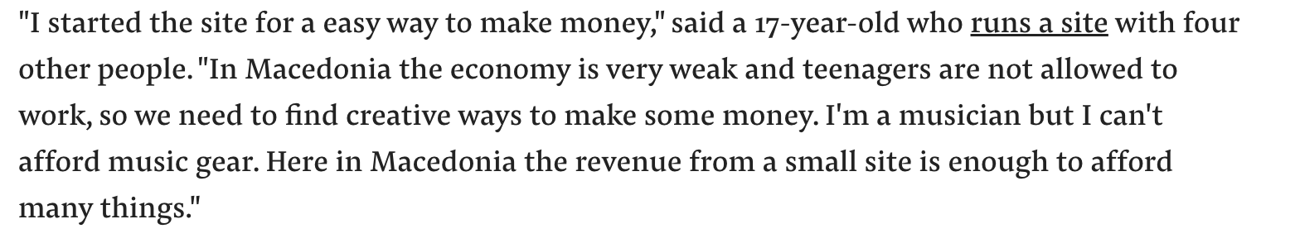
Notes:
Display ad revenue generated by Fake News sites can reach $10,000 to $30,000 per month. One Macedonian teen who publishes Fake News sites told Buzzfeed that advertising revenue could reach thousands of dollars per day or week.

Slide 8
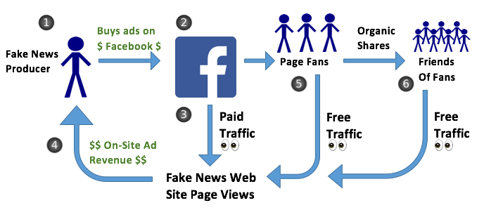
Notes:
An individual publishes false information on a Fake News website, then pays to advertise a link to the post in Facebook users’ newsfeeds.
Facebook profits from advertising on its platform, earning money for every person who clicks the link or every 1,000 users who see the ads.
Facebook users click on the advertised links and go to the Fake News website, generating an impression for each display ad on the website.
The Fake News site earns revenue from the resulting advertising impressions, which amount to millions of page views and tens of thousands of dollars per month.
Fake News producers advertise their Page to fans, growing an organic Facebook audience to whom they can share links at no cost.
Fans can share these links to their own Facebook networks, furthering the organic reach of Fake News. This is how something “goes viral.”

Slide 9
How Google’s Ad Business Funds Disinformation Around the World
In 2019, the Global Disinformation Index, a nonprofit that analyzes websites for false and misleading content, estimated that disinformation websites earned $250 million per year in revenue, of which Google was responsible for 40% and the rest came from other ad tech companies.
NewsGuard, which employs human reviewers to evaluate and rate websites based on a set of criteria including accuracy, estimated in 2021 the annual ad revenue earned by sites spreading false or misleading claims is $2.6 billion. The report did not say how much of that Google might be responsible for.
Notes:
-Keep in mind that all of this is opaque.
-Google doesn’t report on the websites they blocked.

Slide 10

An emerging business – Troll Factories
An entity conducting disinformation propaganda activities on the Internet.
Focus on the political or economic sphere.
Bots: Programs sending out messages automatically, e.g., in response to the appearance of a keyword.
Twitter deleted 2,000,000 fake accounts in 2018 alone.
Professional and amateur trolling.
Linkage of fake profiles.
Notes:
It was Stalin who spread state propaganda outside of Russia by sending 7,000-8,000 articles in English to foreign press outlets.
Not a new phenomenon.

Slide 11
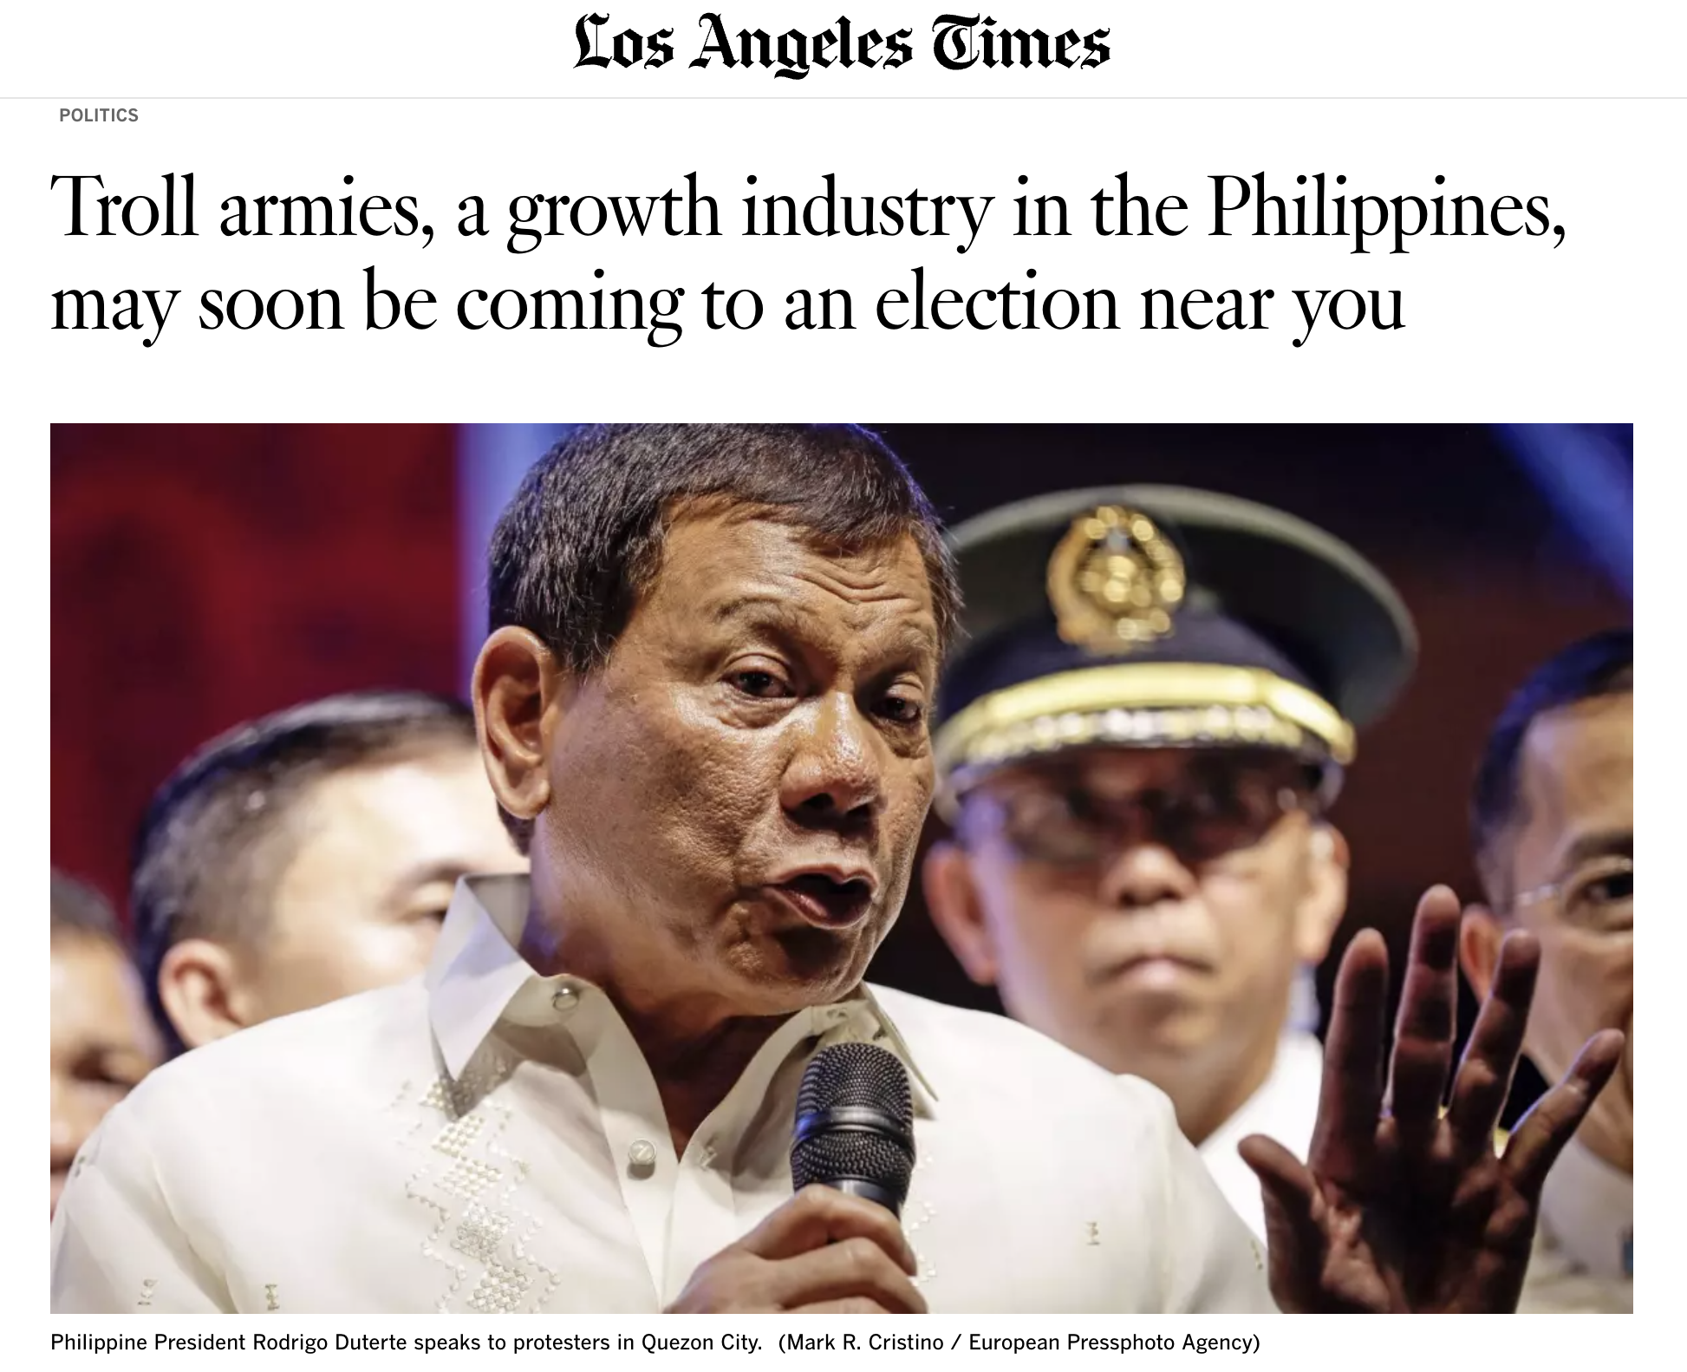
Notes:
They work in coordinated fashion by sharing or commenting on each other’s posts, giving the illusion of a widely held point of view. In some cases, trolling is a service offered by legitimate advertising and public relations firms.

Slide 12
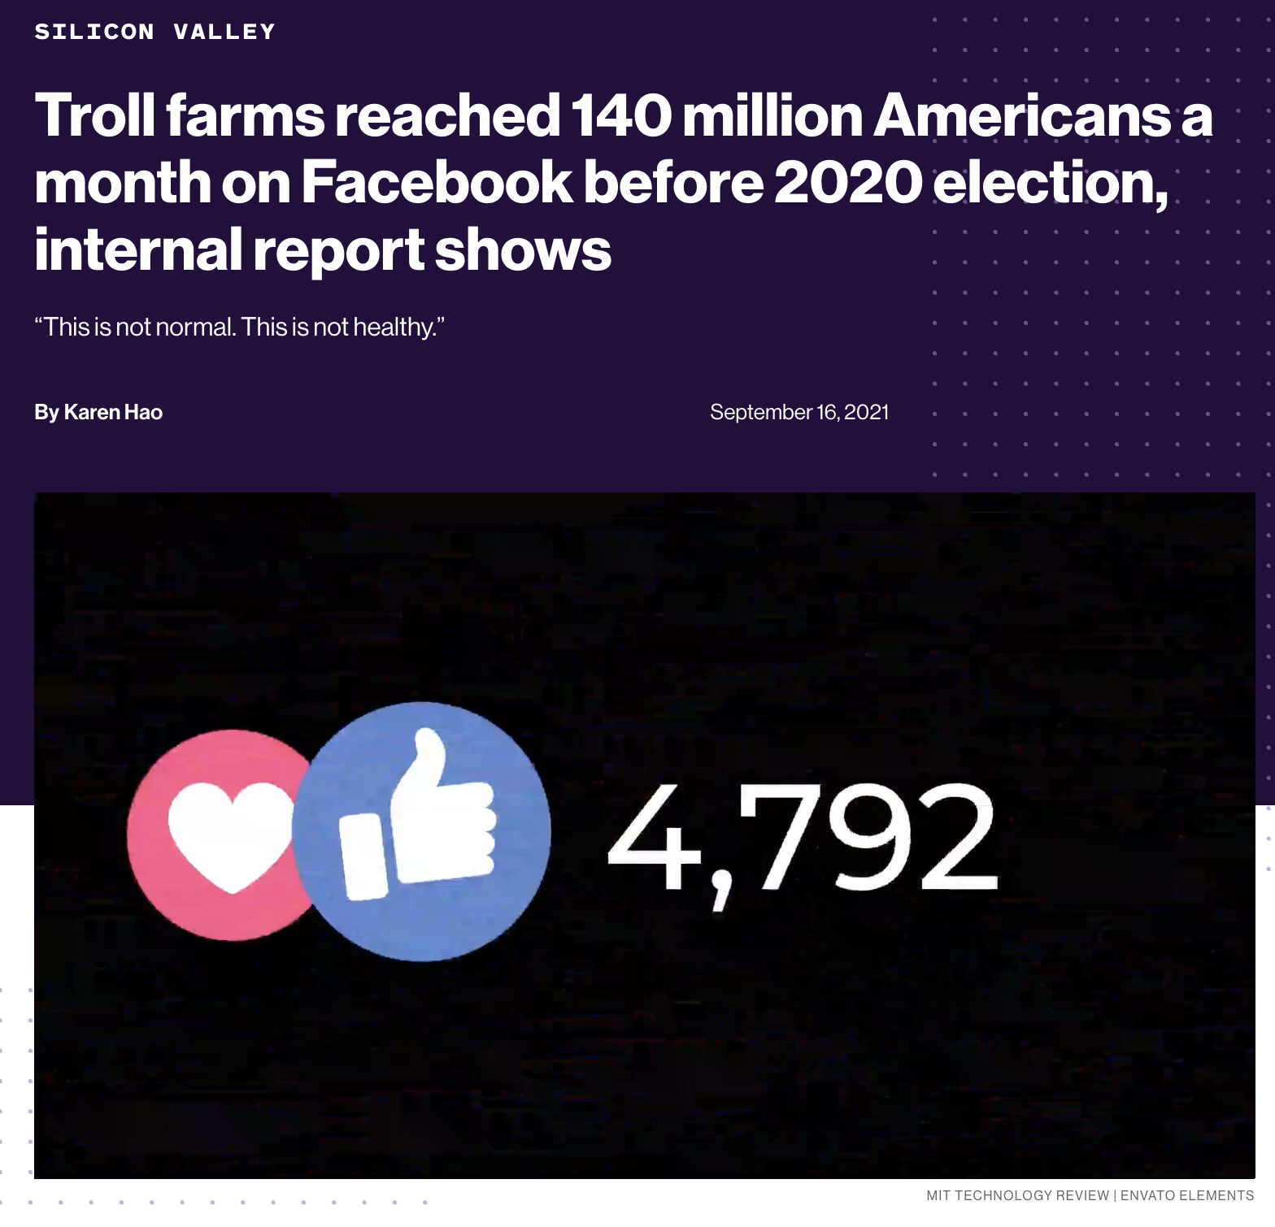
Notes:
This kind of trolling works especially well on Facebook, which has nearly 3 billion users and an algorithm that rewards popular (but not necessarily factual) content by pushing it onto more people’s news feeds. The troll farms’ tactics have been so successful that, leading up to the 2020 election, their content reached 140 million U.S. users per month.
In the run-up to the 2020 election, the most highly contested in US history, Facebook’s most popular pages for Christian and Black American content were being run by Eastern European troll farms. These pages were part of a larger network that collectively reached nearly half of all Americans, according to an internal company report, and achieved that reach not through user choice but primarily as a result of Facebook’s own platform design and engagement-hungry algorithm.

Slide 13
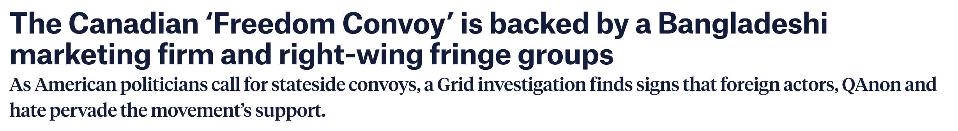
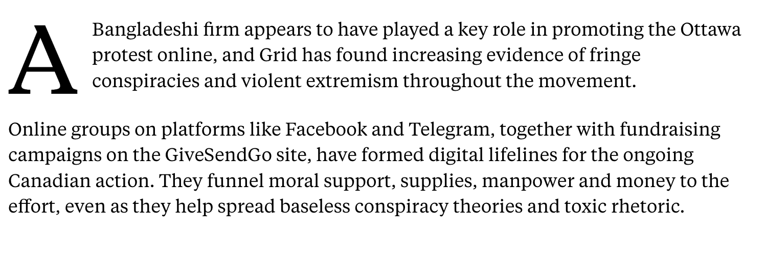
Notes:
Resource mobilization

Slide 14
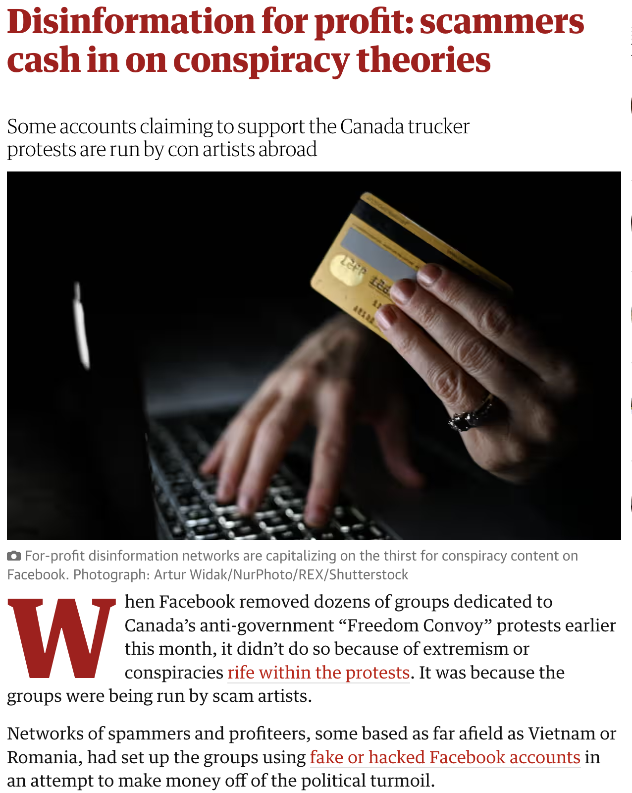
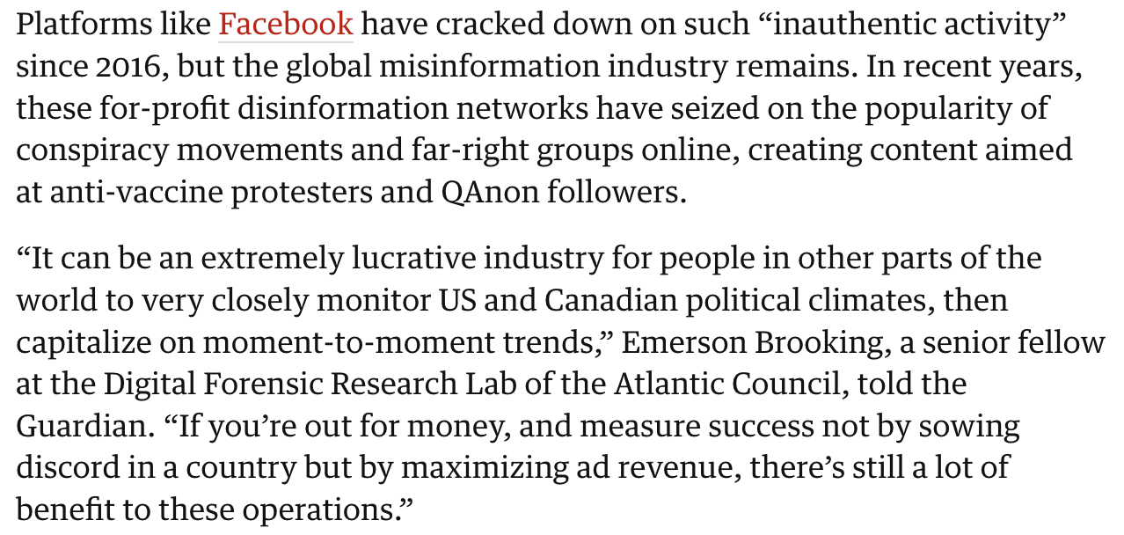
Facebook Report
Notes:
In recent years, social media companies have stepped up their efforts to take down trolls. For example, since 2018, Facebook has been releasing regular coordinated inauthentic behavior (CIB) reports—its September 2022 report highlights the removal of two unrelated networks from China and Russia, spreading disinformation about the war in Ukraine, among other topics.
However, such efforts may not be enough. One Facebook employee-turned-whistleblower argues that the company still hasn’t really changed the way it does business—largely acting in the interest of profit—and that CEO Mark Zuckerberg doesn’t hold himself accountable. (For his part, Zuckerberg denies the whistleblower’s allegations that Facebook puts profit over the public good, while adding that the government needs new internet regulations.)

Slide 15
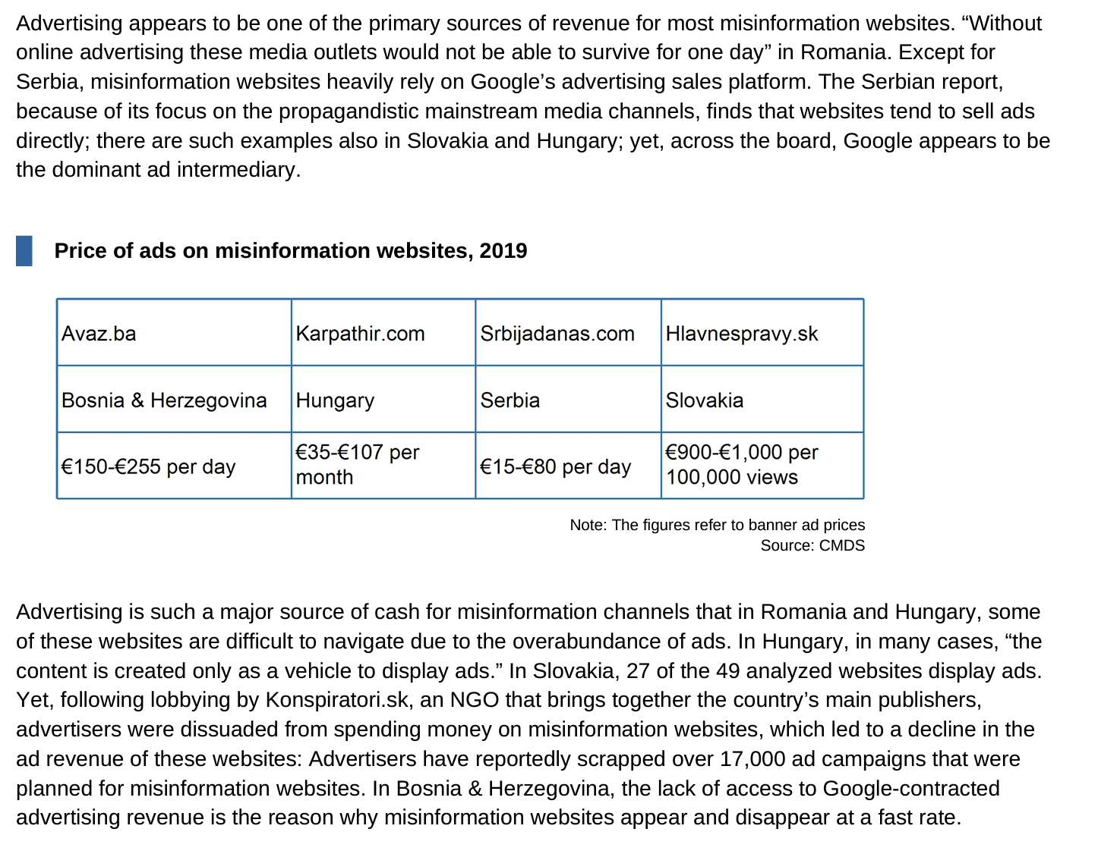


Slide 16
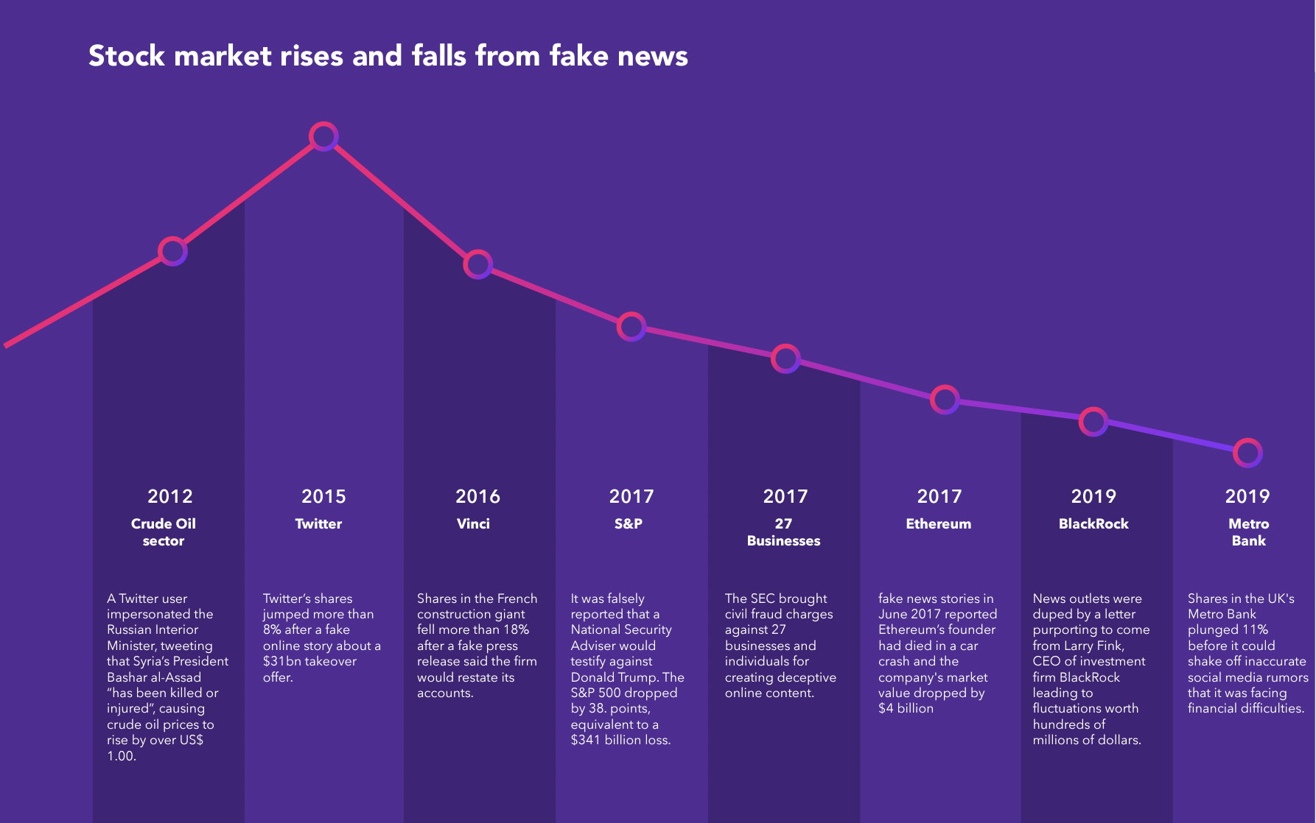
The costs of disinformation
University of Baltimore, 2019
Notes:
- This is only in stock markets, but it applies to public health misinformation, online safety, public spend, and so on.
- Influenza

Slide 17
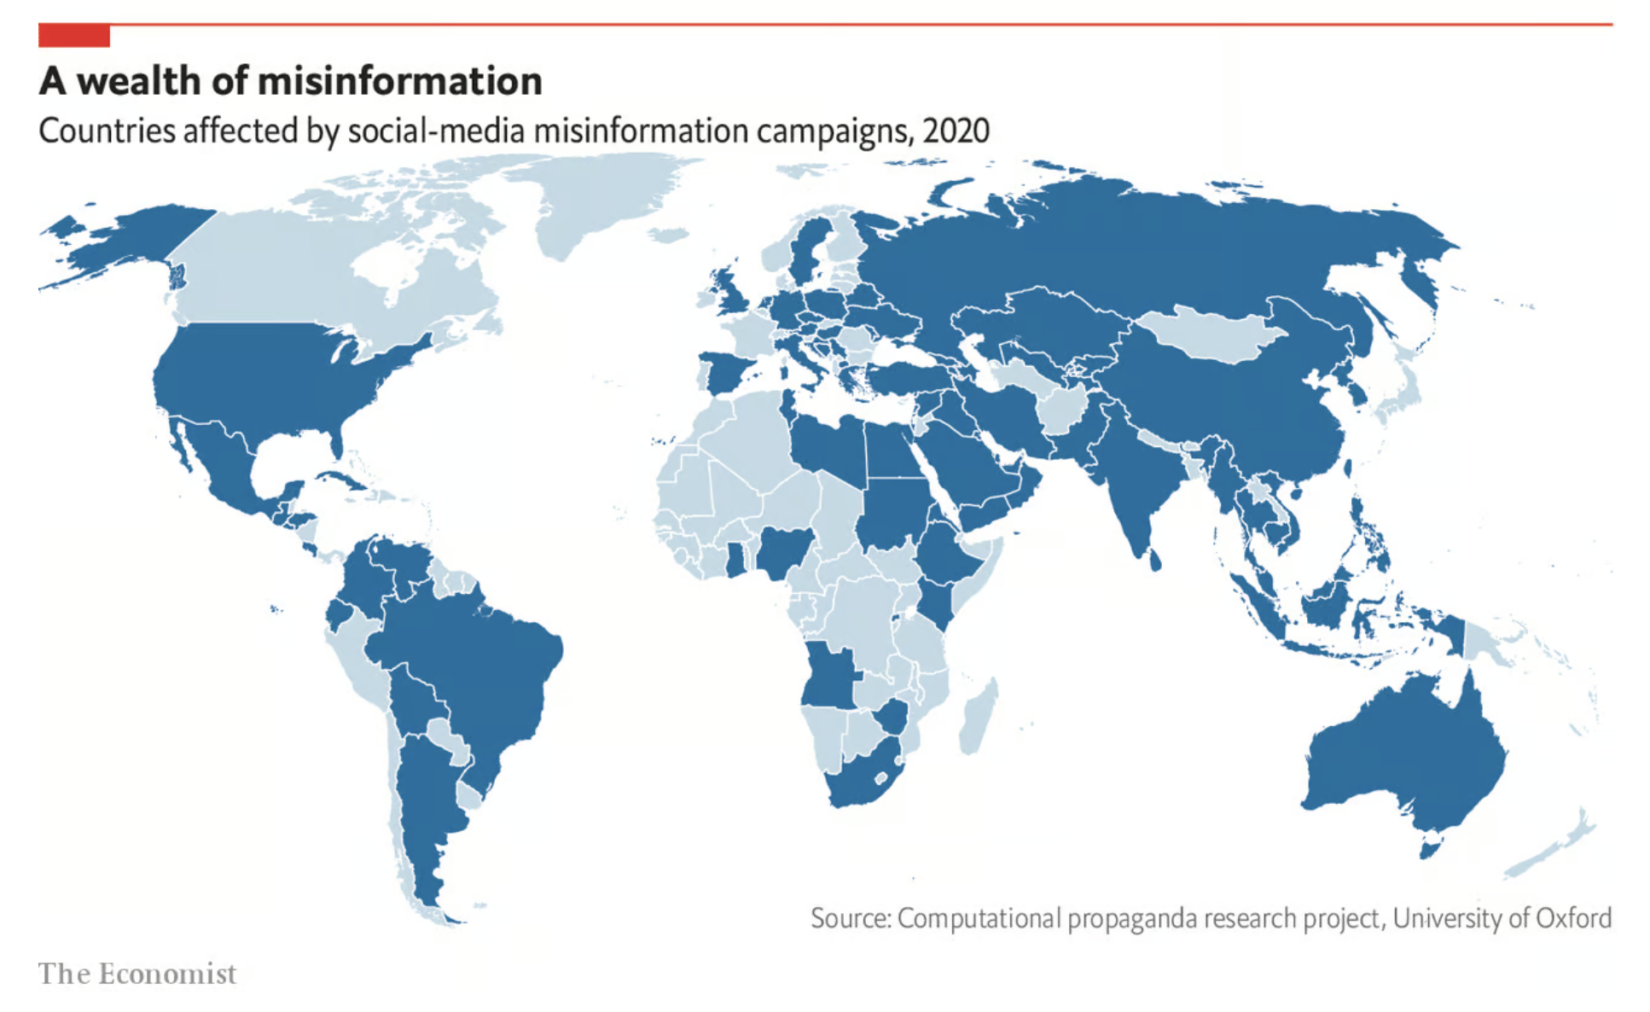
Failing infrastructures
It is easy and cheap to produce fake news.
It is also easy to have a good reception if you are part of a network of accounts.
Content verification usually comes later, after the damage is done.
It is impossible for humans to verify all the content published, so controlling disinformation is difficult.
Notes:
The truth is that it’s easy and cheap to produce a video with false news and effective words based on trends, “keywords,” and topics of interest on social media.
The next steps are to upload it and hope that people will see it and that it’ll go viral.
Content verification usually comes later, and it’s done by third parties, like fact-checkers, after the damage is done.
“it’s impossible for humans to verify all the content published, so controlling disinformation is difficult.”
In Latin America, according to Comscore, influencers posts represented 16.3% of the total amount of content published regarding any type of topic. The network with the highest number of influencers is Instagram (37%), followed by Facebook (30%), YouTube (28%) and Twitter (5%).
Legislation to control this.

Slide 18
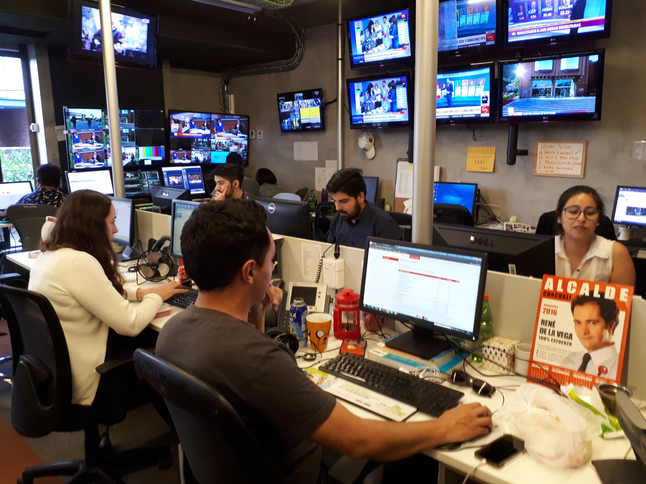
The costs of disinformation
Notes:
Take a person out and put them to do factchecking. But
Interview with La Tercera

Slide 19
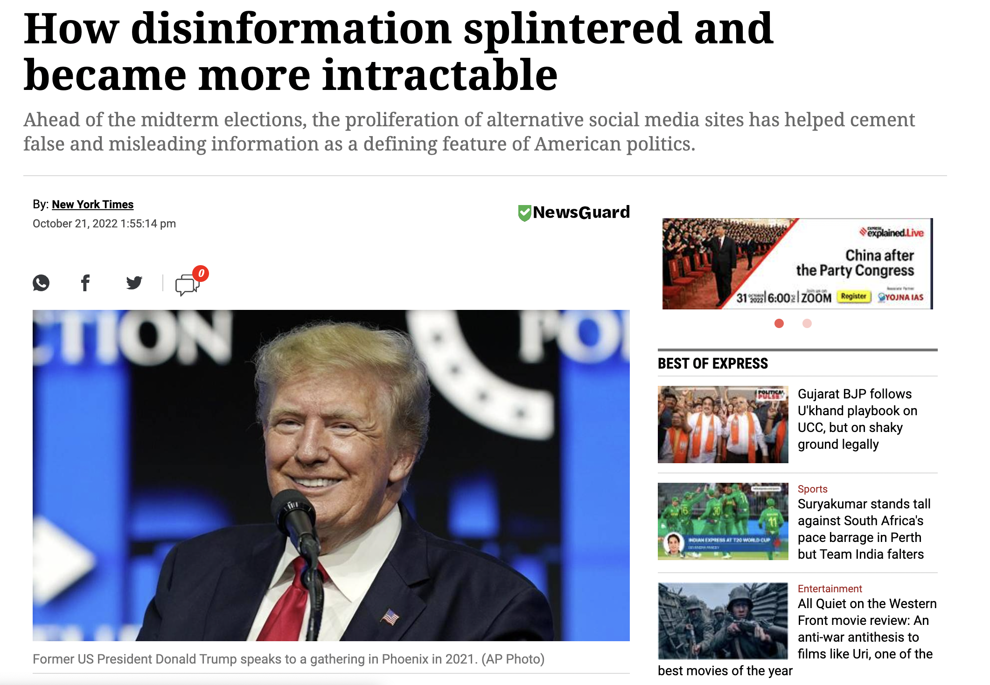





Notes:
At least 69 million people have joined platforms, like Parler, Gab, Truth Social, Gettr and Rumble, that advertise themselves as conservative alternatives to Big Tech, according to statements by the companies. Although many of those users are ostracized from larger platforms, they continue to spread their views, which often appear in screenshots posted on the sites that barred them.
A new survey by the Pew Research Center found that 15% of prominent accounts on those seven platforms had previously been banished from others like Twitter and Facebook.
Breton last month gave TikTok, owned by China’s ByteDance, an Oct. 25 deadline to provide information on its crisis response measures and also ordered the company to provide details by Nov. 8 on how it protects the integrity of elections and minors online on its platform.

Slide 20
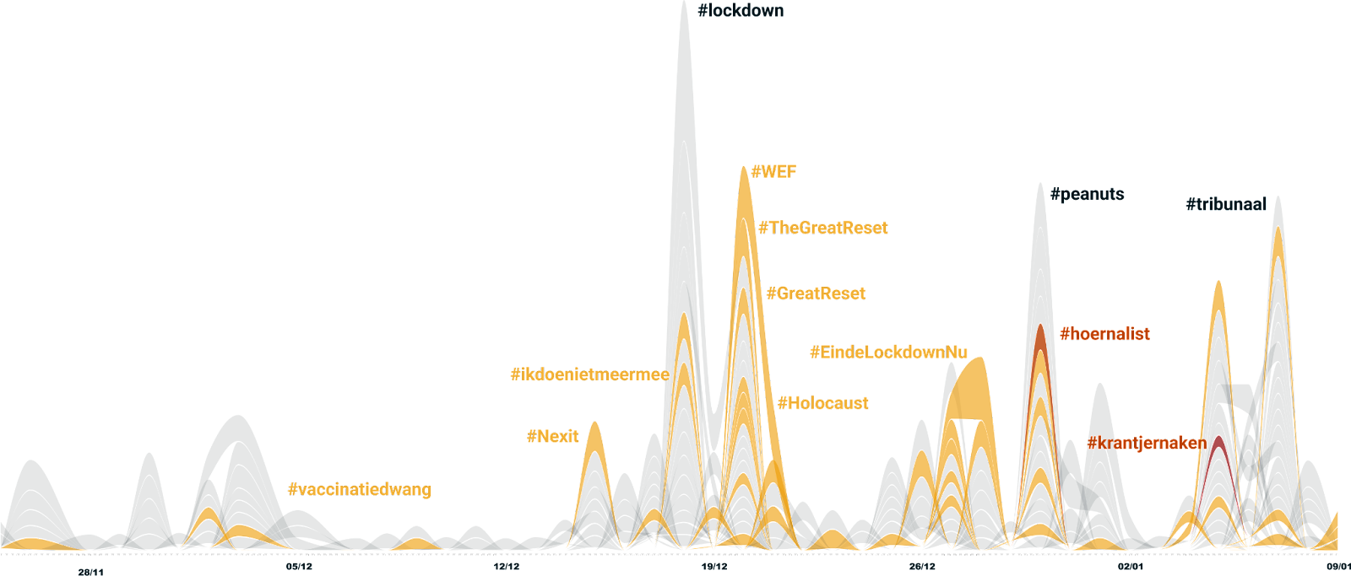
Journalists getting entangled with disinformation
Notes:
Figure 1 Hashtags over-time for Dutch journalist Wierd Duk (De Telegraaf, male). Tags pertain mainly to the pandemic and topics covered by Duk. The orange tags are pertaining to him being a 'whorenalist' and the like...

Slide 21
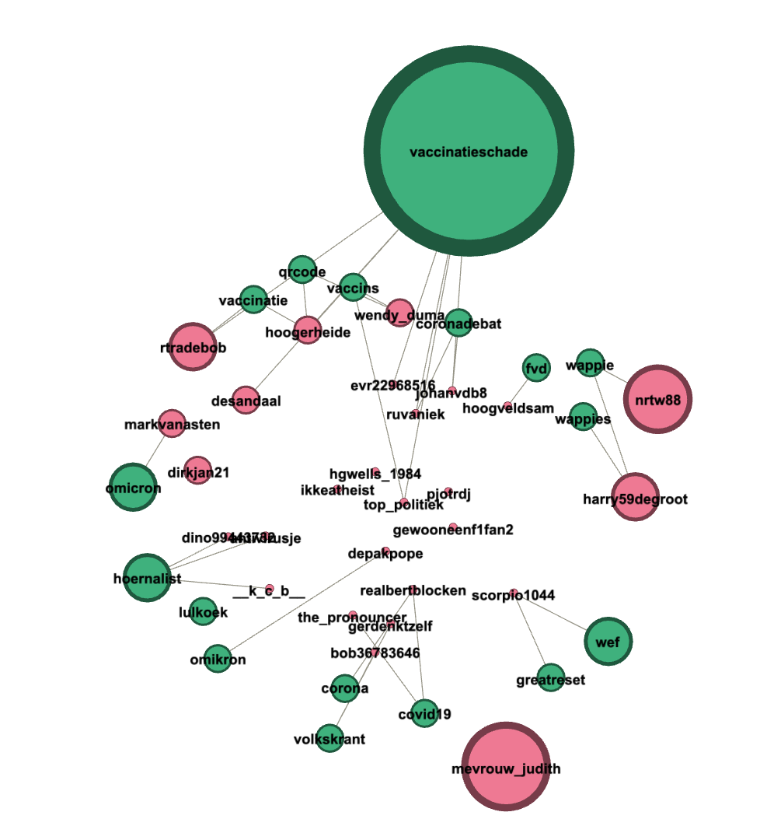
Notes:
NL journalists hashtags: Maarten Keulemans
Figure 3: Tags and users surrounding male journalist Maarten Keulemans (de Volkskrant, note that this is the same paper as Asha ten Broeke in figure 2).

Slide 22
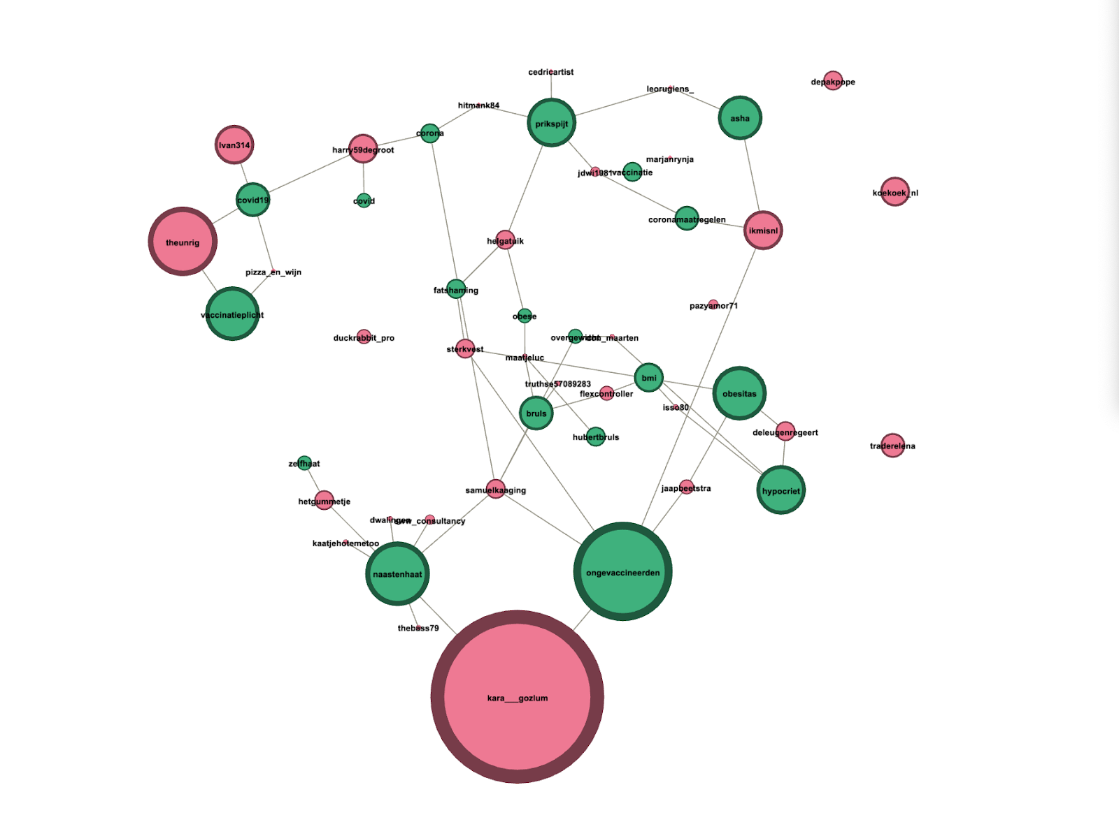
Notes:
Asha ten Broeke - Volkskrant
Figure 2: hashtag-user network of the dataset pertaining to Asha ten Broeke (female Dutch journalist, de Volkskrant). Note how her physical appearance gets dragged in through tags such as fat shaming and BMI. This is also the case for the UK journalist Laura Kuenssberg, see figure 4, although this is almost not visible through the tags (see also the limitations section).

Slide 23
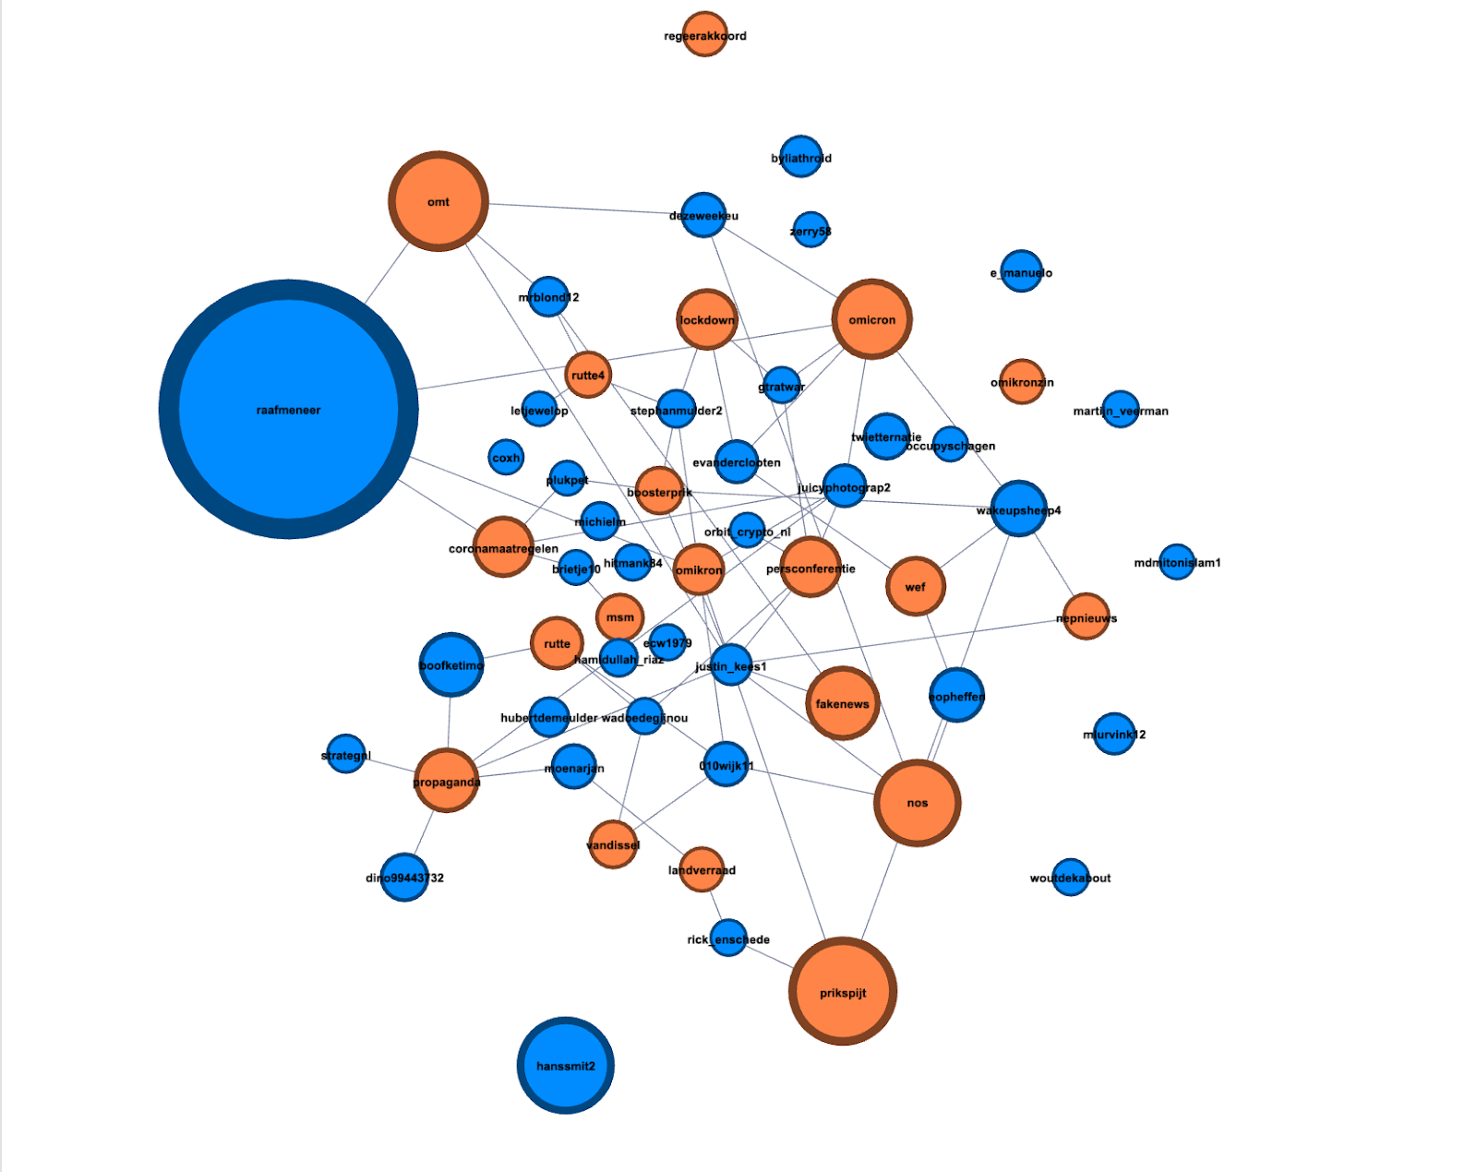
Notes:
NL outlet hashtags: NOS

Slide 24
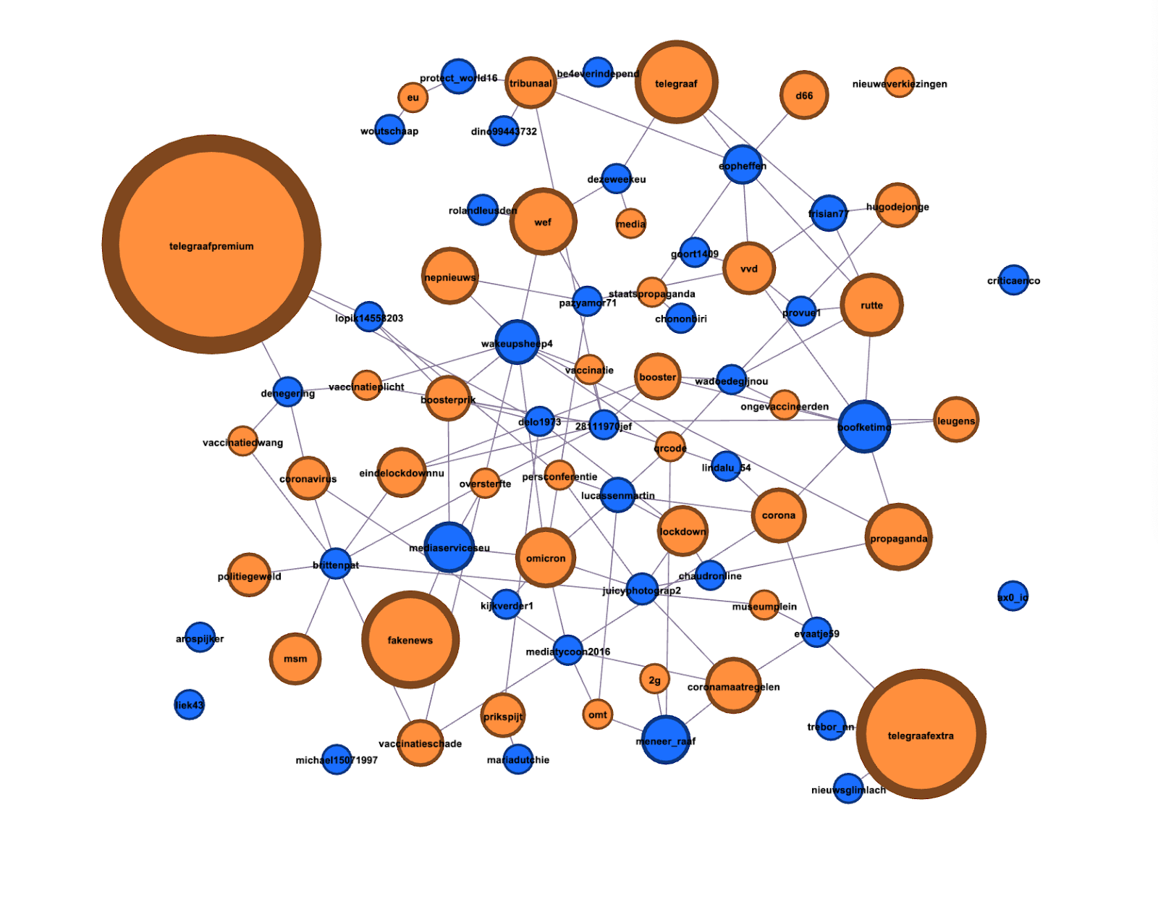
Notes:
NL outlet hashtags: Telegraaf

Slide 25
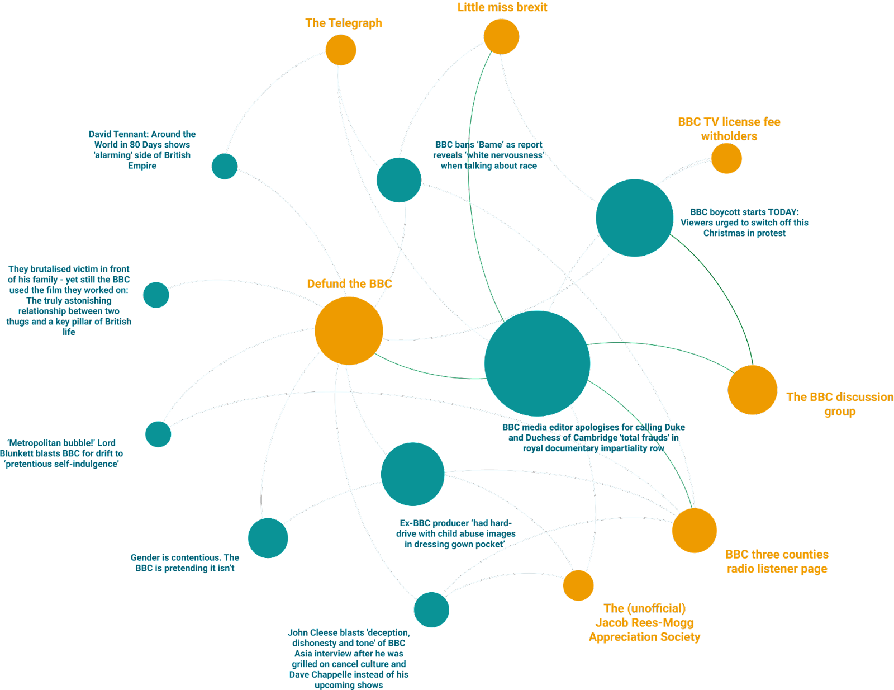
Notes:
Figure 9. Network of Facebook pages (yellow nodes) sharing similar news content (blue nodes). Made with the CrowdTangle plugin extension. Following the top ten most interacted news articles shared on the Defund the BBC Facebook page, which was also featured as a significant hashtag on Twitter. These kinds of analyses provide for a sense of the Facebook page ecology and how pages use (similar) news articles to further their causes.

Slide 26
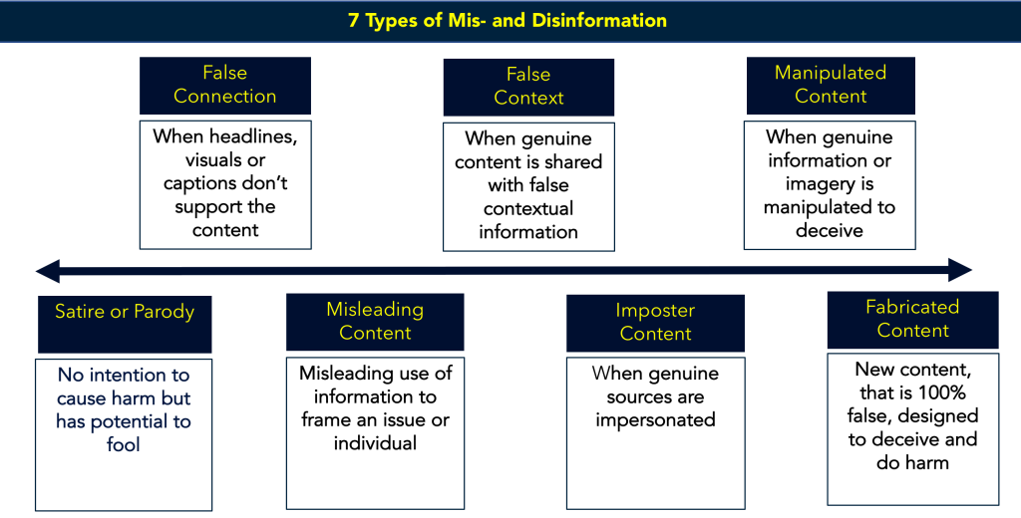
The impact of misinformation in news
Is misinformation always bad?
It is a shift toward a more decentralized media ecology.
Feelings are as important as facts.
“I think a lot of the reaction to ‘fake news’ has been a moral panic. Much of what we – and Trump – calls fake news or post truth or filter bubbles – is simply what we disagree with or feel threatened by.” – C. B.
First Draft News, 2017
Notes:
Just because information doesn't necessarily align with your personal views that you have already doesn't mean that it's fake.
Firstly, let’s recognize that ‘fake news’ is an umbrella term
It is a wake up call to be more transparent, relevant, and to add value to people’s lives.
It can develop a new business model of fact checking, myth busting and generally getting its act together as a better alternative to fakery.

Slide 27
The impact of misinformation in news
Journalists should:
Curate – help users to good content where ever it is
Be relevant – use users’ language and ‘listen’ creatively with data
Be expert – add value, insight, experience, context
Be truthful – fact checking, balance, accuracy
Be human – show empathy, diversity, constructive
Transparency – show sources, be accountable, allow criticism
The networks and other organizations that distribute news should:
Filter out fake news better
Give the user better signals of the quality of content
Promote better content through algorithms
Promote news literacy
Ensure more resource and reward goes to credible producers and publishers
Other authorities (government, business, education) should:
Communicate where the public communicate
Talk the right languages: conversational, human, even humorous
Be relevant
Open up
Be interactive
Be realistic – media has limited influence
Notes:
- Charlie Beckett

Slide 28
Assisting Journalism – Fact-Checking Africa
The emergence of data-driven grassroots organizations
Data advocates seek to reformulate fact-checking processes within media.
Incorporated technological, data and journalism practices with varying goals, from holding media and politicians accountable to engaging citizens in news production
Rare example of a genuinely transnational movement in journalism
“Following the logics of fact-checking, data have the ability to become a journalistic source that, veiled in a discourse of objectivity, signifies a qualitative measure of journalistic success.”
The practice of fact-checking seems to be moving towards the periphery of journalism, performed by external actors.
“We have to stop pretending that media are the gatekeepers of information and that we are the only ones that can make sense of it and we need to start sharing our sources and our resources and our methodology with our audiences, to educate them to become fact checkers themselves. (AC4)”

Slide 29
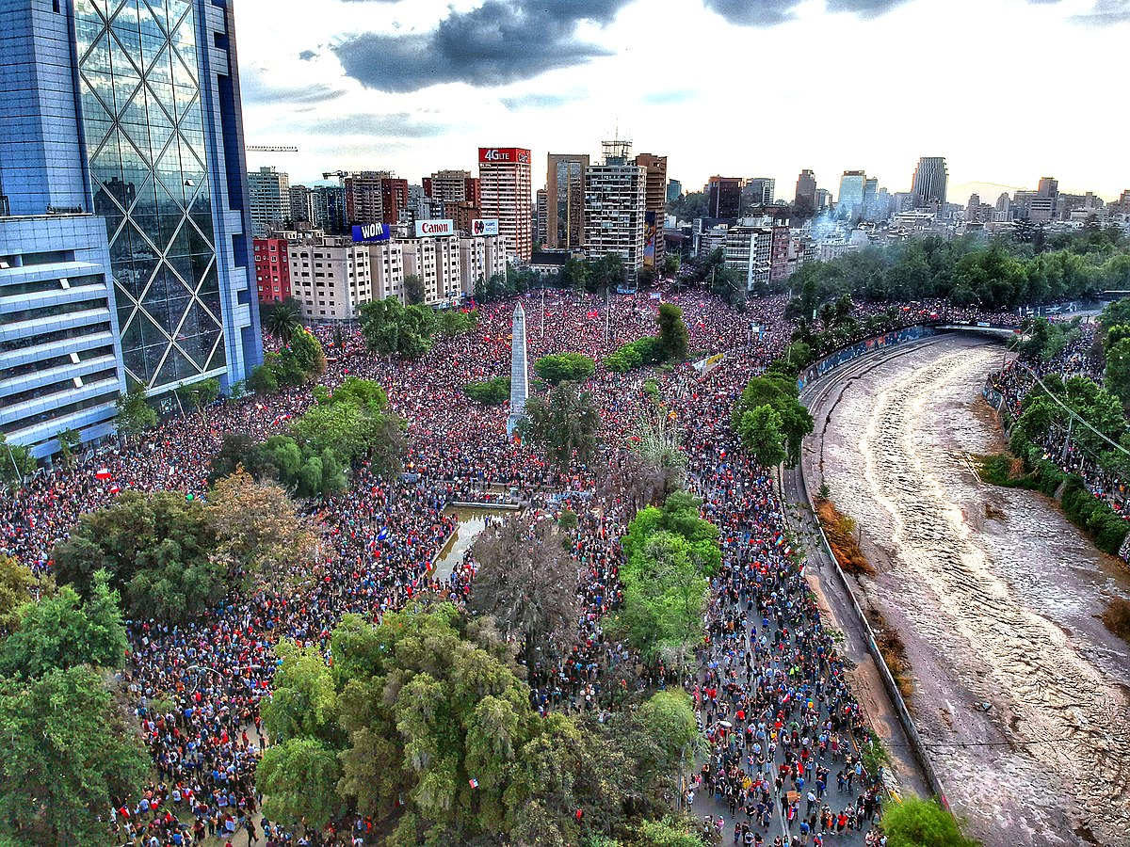
Assisting Journalism
Notes:
“The internet is essential infrastructure, and just as we hold companies accountable for polluting our air, waterways and food, we must hold companies accountable for polluting our families, kids and communities.”
disseminate the information is a business decision,

Slide 30

Assisting Journalism

Slide 31


Assisting Journalism

Slide 32
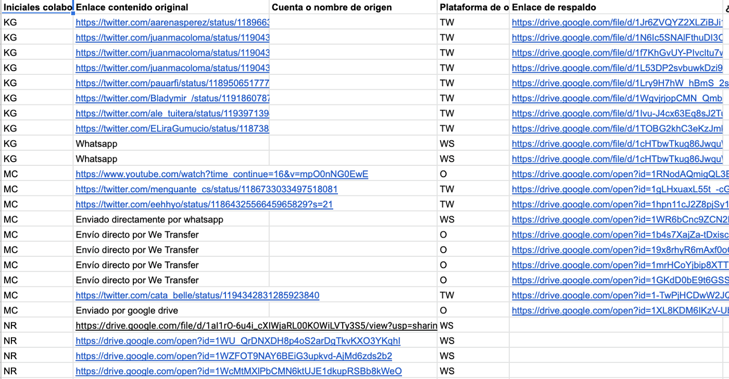
Assisting Journalism

Slide 33
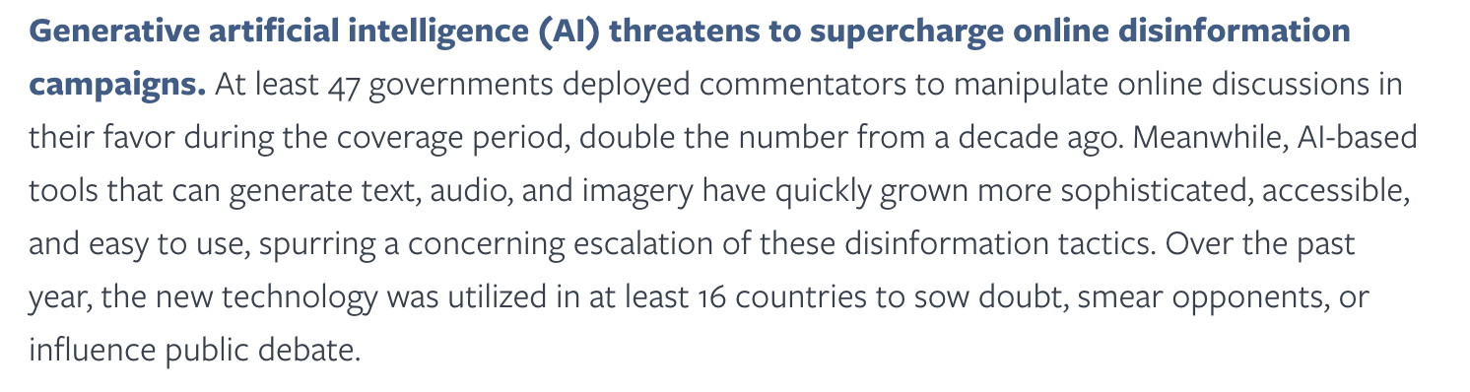
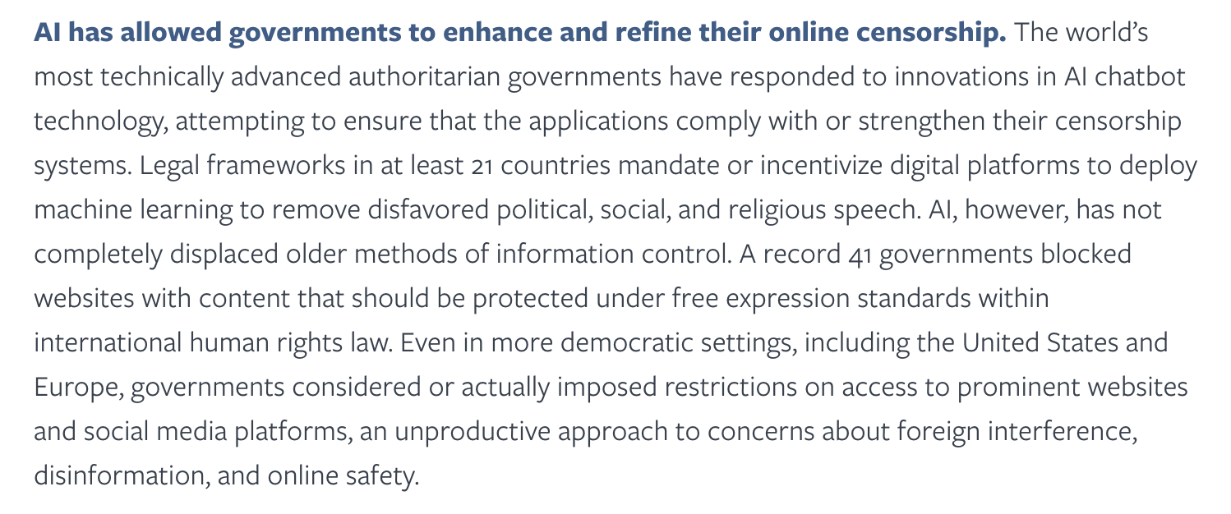
Generative AI
Notes:
Freedom House
To manipulate online discussions
Generate answers

Slide 34
Market power
Platforms’ technological organising principles transform news media organisations and make them align with the social and economic objectives of social media companies.
Other scholars contend that the algorithmic logics of dominant platforms have an ‘isomorphic’ impact on news media organisations, causing them to adopt the priorities and values of these platforms.
The dependency model explains the status quo for much of the 2010s where news media organisations had been dependent on platforms for audiences, website traffic and distribution. In terms of social media, this can be seen through a brief account of Facebook’s growing interest in news.
The first intervention occurred in 2013 when Facebook started to boost the posts of news publishers through changes to its algorithm, thereby incentivising Facebook-focused distribution strategies for news media organisations seeking digital traffic. However, Facebook soon realised that all they were doing was delivering audiences to the websites of news media organisations. So in response, they started to develop technologies that served content on their platform alongside a public narrative, which implied that adoption of these tools would deliver economic benefits for news media organisations
Source

Slide 35
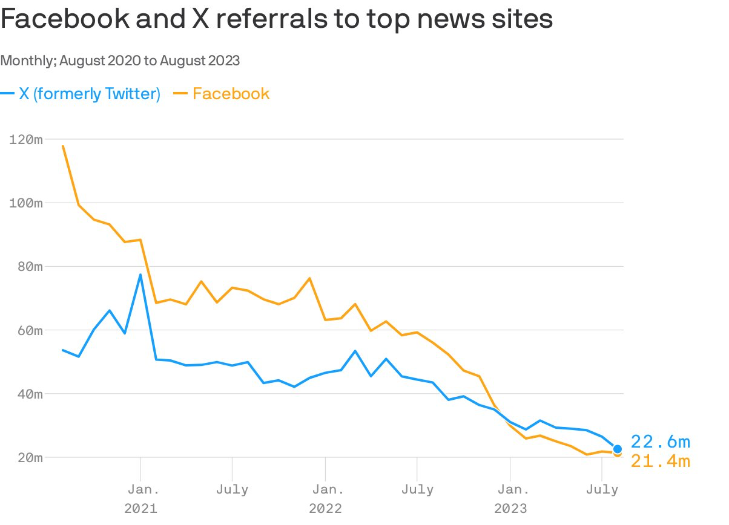
Notes:
las plataformas buscan blindarse de responsabilidad ante contenidos ajenos que, sobre todo en contextos electorales, pueden ser piezas de desinformación. Es una de las formas en que metabolizan regulaciones al respecto como la DSA europea.
la decisión de las plataformas de derivar mucho menos tráfico hacia medios y fuentes externas busca concentrar la atención de usuarias/os en la propia red (economía de la atención) y, además, zafar de conflictos cada vez más fuertes por derechos de autor de esas fuentes externas.
“However, a collapse in relations soon followed. Tensions grew between the two parties, as news media organisations soon realised that they were unable to generate a sufficient income from social distribution as Facebook started to favour its own platform.”

Slide 36
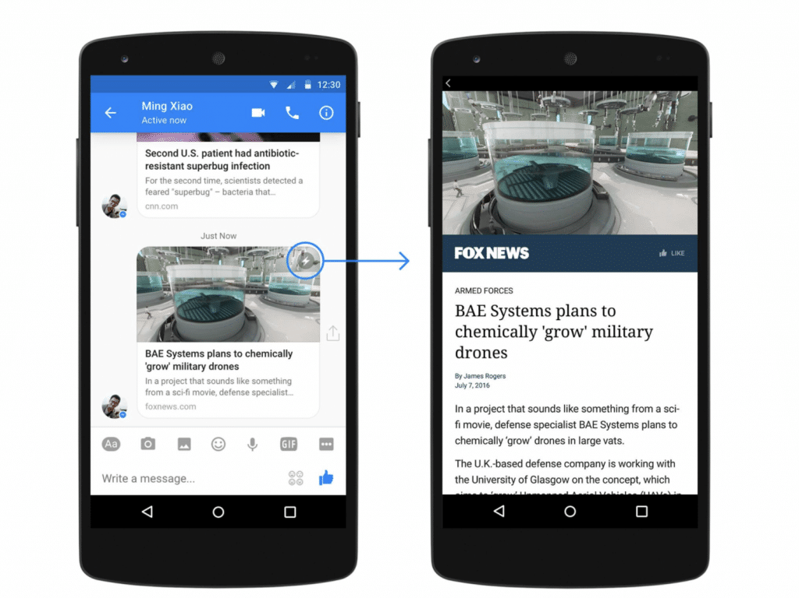
Instant articles
Notes:
In a nutshell, Instant Articles is a feature that pulls the entire post from your website and displays it within the Facebook mobile app. Some of the formatting will remain, such as headers or bullet points.
However, this service only pulls the post itself and not the rest of your site. Things like header images, footers and widgets may not be converted. The content will still belong to you while referencing the website.
Facebook limits the number of ads delivered through Instant Articles. This can greatly reduce the income from those services.

Slide 37
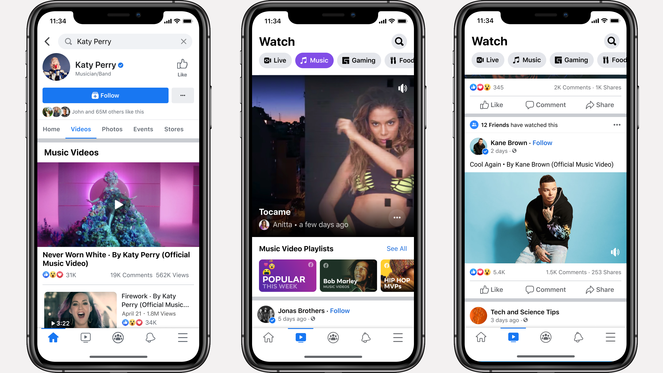
Facebook video
Notes:
Second, media companies who followed Facebook’s move to video soon found out that Facebook had inflated their video metrics. This caused publishers to dump video almost as quickly as they adopted it, leading to further restructures and layoffs (Oremus, 2018).

Slide 38
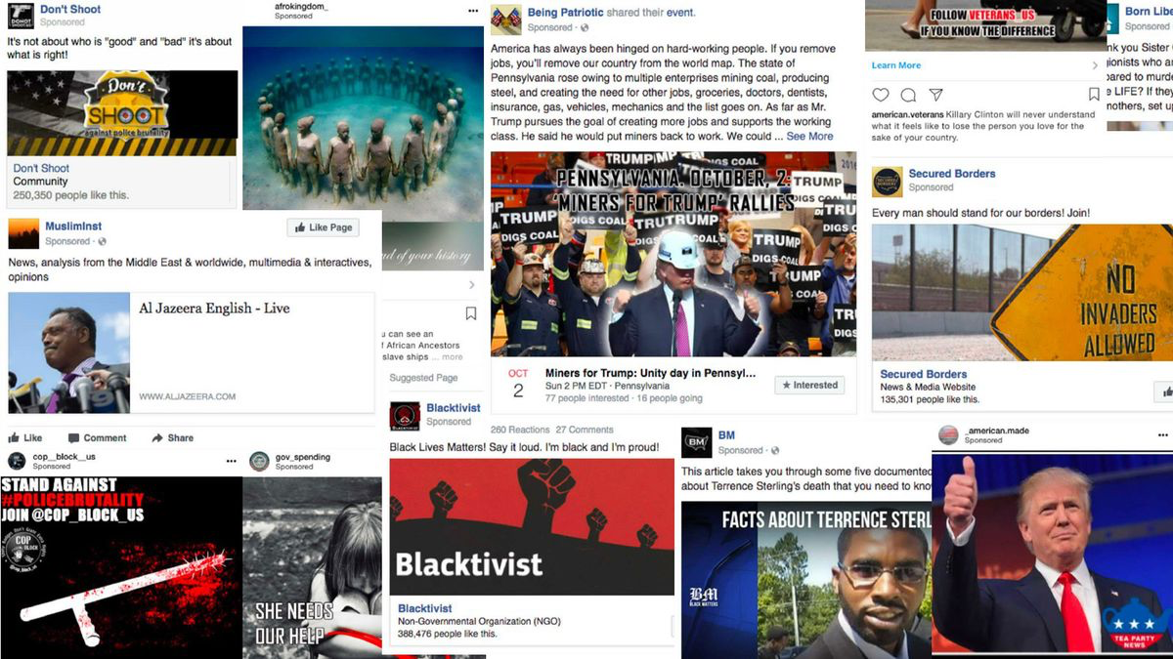
2016 US Election
Notes:
The third development was Facebook’s response to the fallout from the 2016 US election, which saw Facebook come under criticism for distributing misinformation across its platform (Tandoc et al., 2018; Vaidhyanathan, 2018). Realising that news was now a business risk rather than an opportunity, Facebook stepped away for news distribution. The most notable evidence of this shift occurred in January 2018, when the company changed its News Feed algorithm to show ‘more posts from friends and family’ and limit the amount of content displayed by publishers and businesses (Mosseri, 2018).

Slide 39
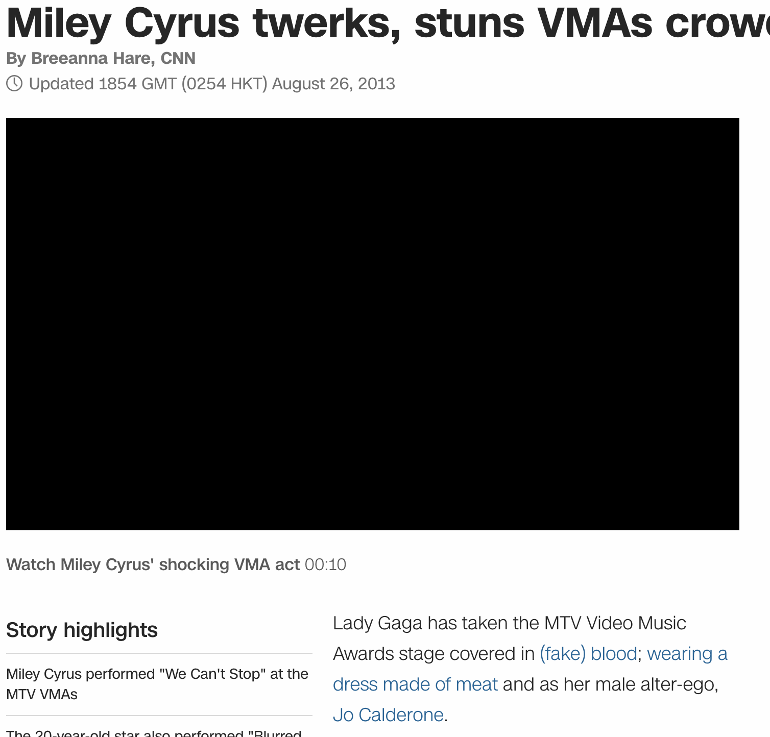
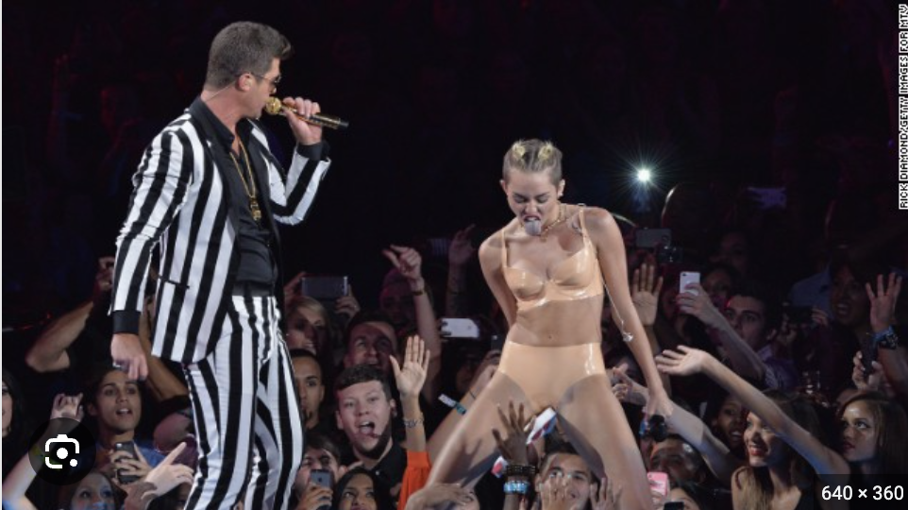
Erosion of gatekeeping
Notes:
Explanation: Traditional gatekeepers, such as editors, played a role in vetting information. In digital platforms, the absence of strong gatekeeping mechanisms allows unverified content to reach a wide audience.
With the diminishing role of traditional gatekeepers, how can journalists adapt their fact-checking processes to maintain credibility and trustworthiness?

Slide 40
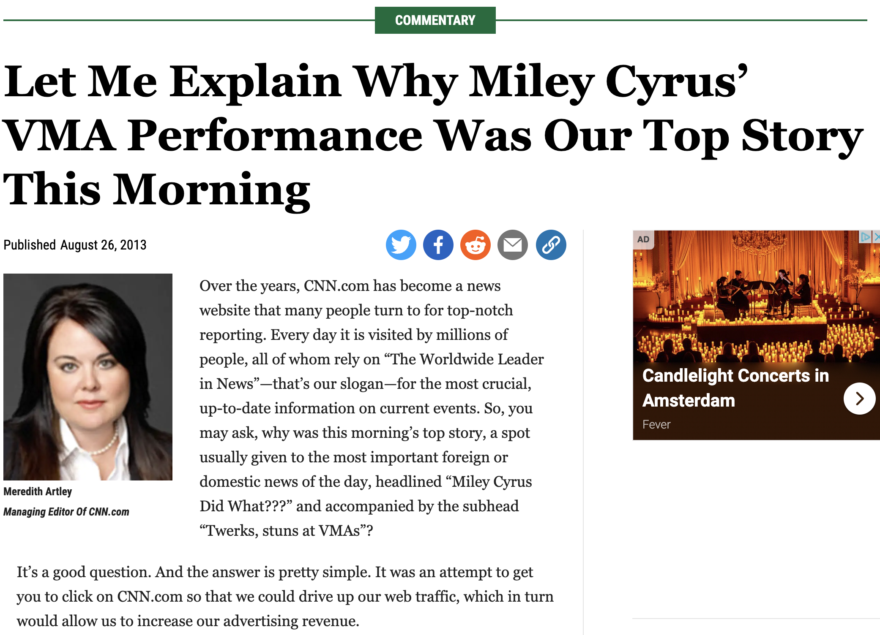
Erosion of gatekeeping
Notes:
Explanation: Traditional gatekeepers, such as editors, played a role in vetting information. In digital platforms, the absence of strong gatekeeping mechanisms allows unverified content to reach a wide audience.
With the diminishing role of traditional gatekeepers, how can journalists adapt their fact-checking processes to maintain credibility and trustworthiness?

Slide 41
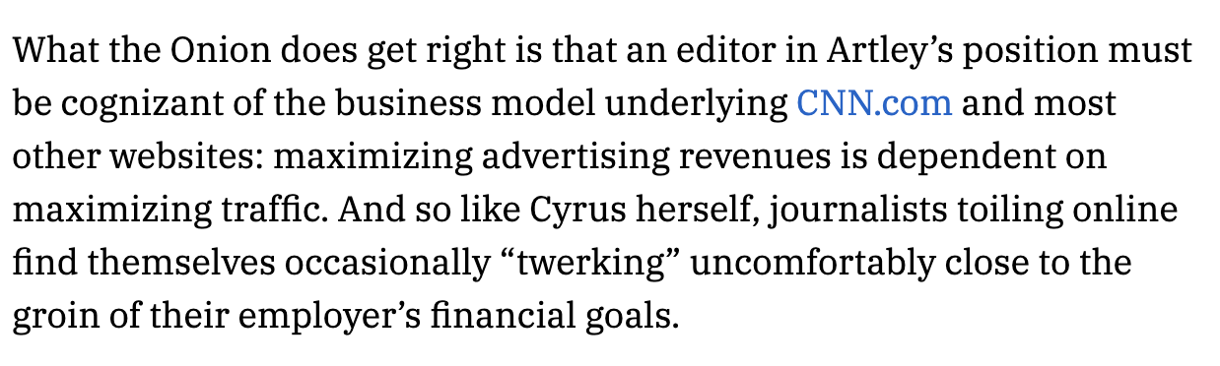
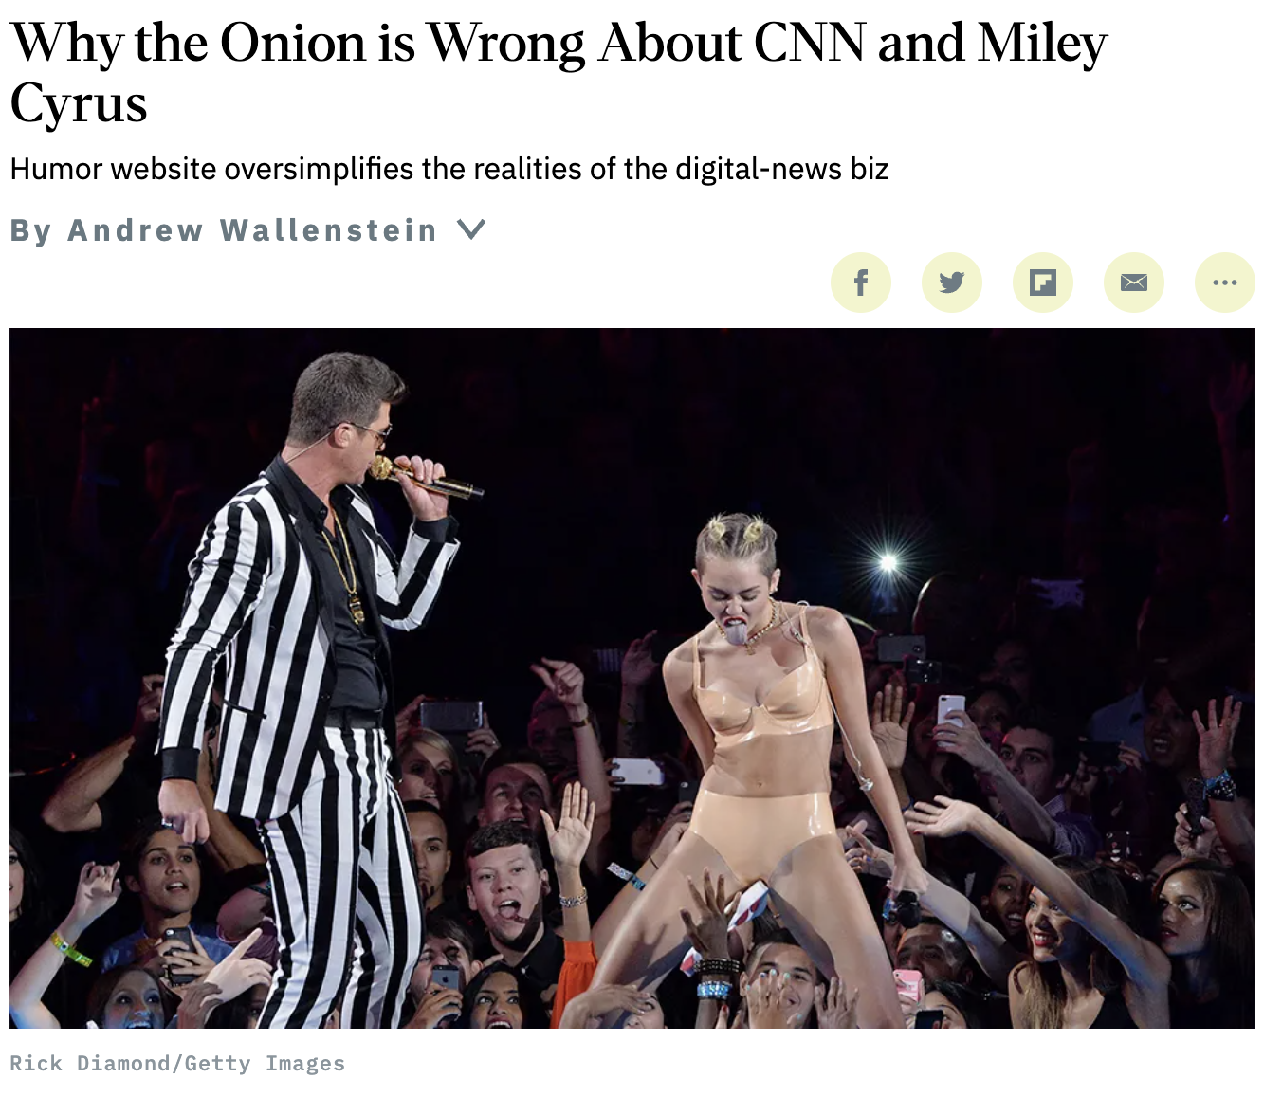
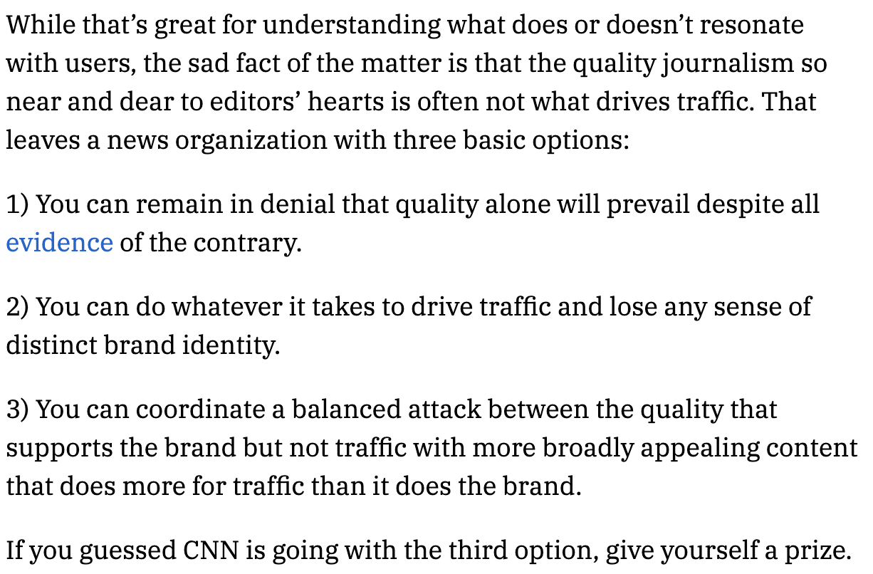
Erosion of gatekeeping
Notes:
Explanation: Traditional gatekeepers, such as editors, played a role in vetting information. In digital platforms, the absence of strong gatekeeping mechanisms allows unverified content to reach a wide audience.
With the diminishing role of traditional gatekeepers, how can journalists adapt their fact-checking processes to maintain credibility and trustworthiness?

Slide 42
Gatekeeping theory
Gatekeeping is “the process of selecting, writing, editing, positioning, scheduling, repeating, and otherwise massaging information to become news” (Source).
Journalists used to ignore, if not reject, feedback from the audience.
As years passed, and even with newer audience measurement systems such as readership surveys and television ratings, journalists still relied on their supervisors, peers, relatives, and personal preferences for their news judgment.
But new information technologies are offering new ways of interaction between audiences and messages. Newsrooms in the United States have embraced web analytics, and editors can now monitor how users behave online based on audience metrics. (Source).

Slide 43
Filter bubbles
A filter bubble is a state of intellectual or ideological isolation that may result from algorithms feeding us information we agree with, based on our past behaviour and search history. (Source).
An echo chamber is what might happen when we are overexposed to news that we like or agree with, potentially distorting our perception of reality because we see too much of one side, not enough of the other, and we start to think perhaps that reality is like this.
Filter bubbles describe a situation where news that we dislike or disagree with is automatically filtered out and this might have the effect of narrowing what we know. This distinction is important because echo chambers could be a result of filtering or they could be the result of other processes, but filter bubbles have to be the result of algorithmic filtering.
Notes:
Filter Bubbles and Echo Chambers:
Explanation: Users on digital platforms may be confined to filter bubbles and echo chambers, where they are exposed to information that aligns with their existing beliefs. This can make it difficult for journalists to present a balanced and accurate picture.
How might journalists disrupt filter bubbles and echo chambers to ensure a more comprehensive and unbiased understanding of information? What responsibilities do platforms bear in this regard?

Slide 44
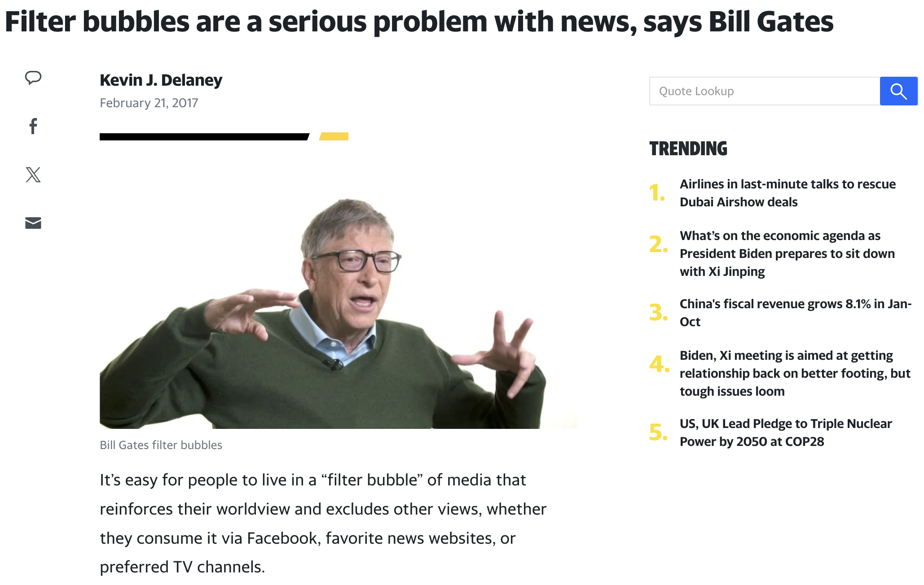
Filter bubbles

Slide 45
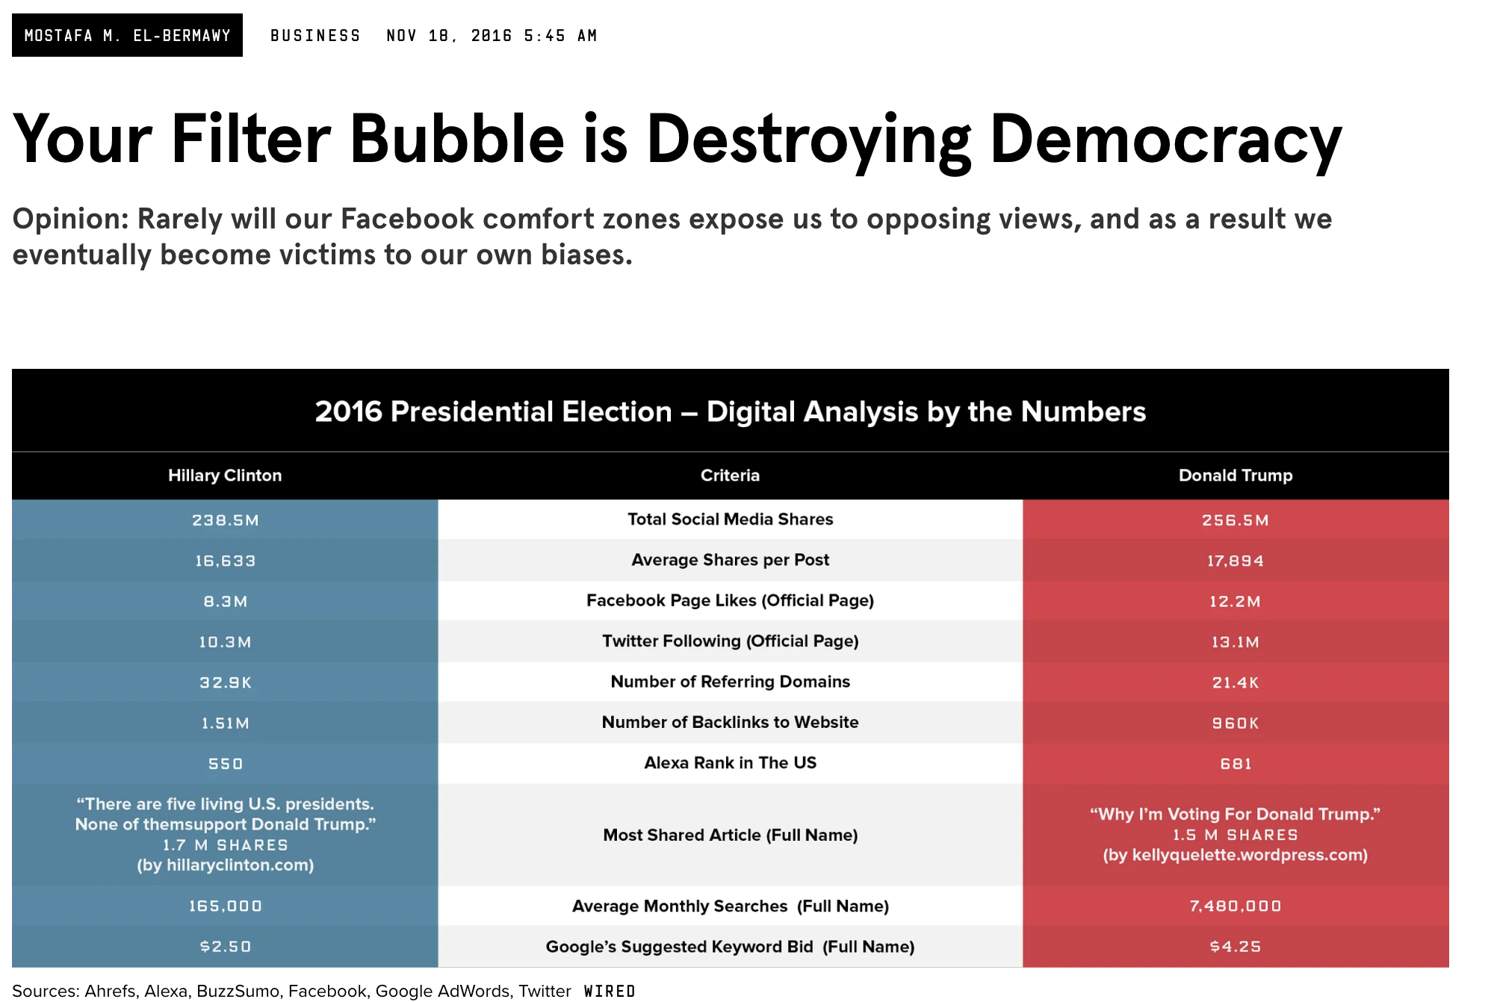
Filter bubbles

Slide 46
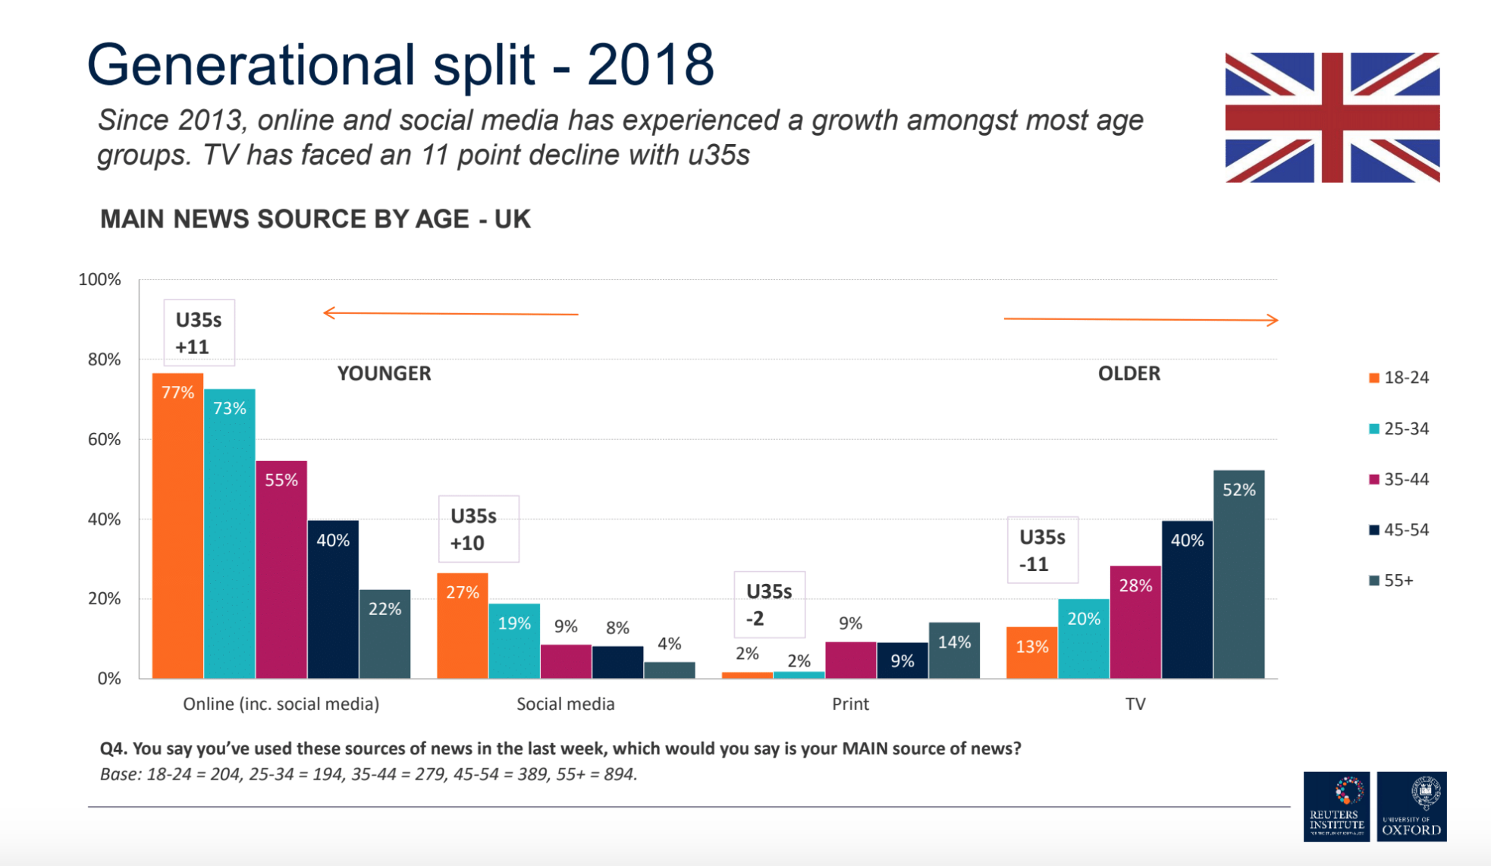
Filter bubbles

Slide 47
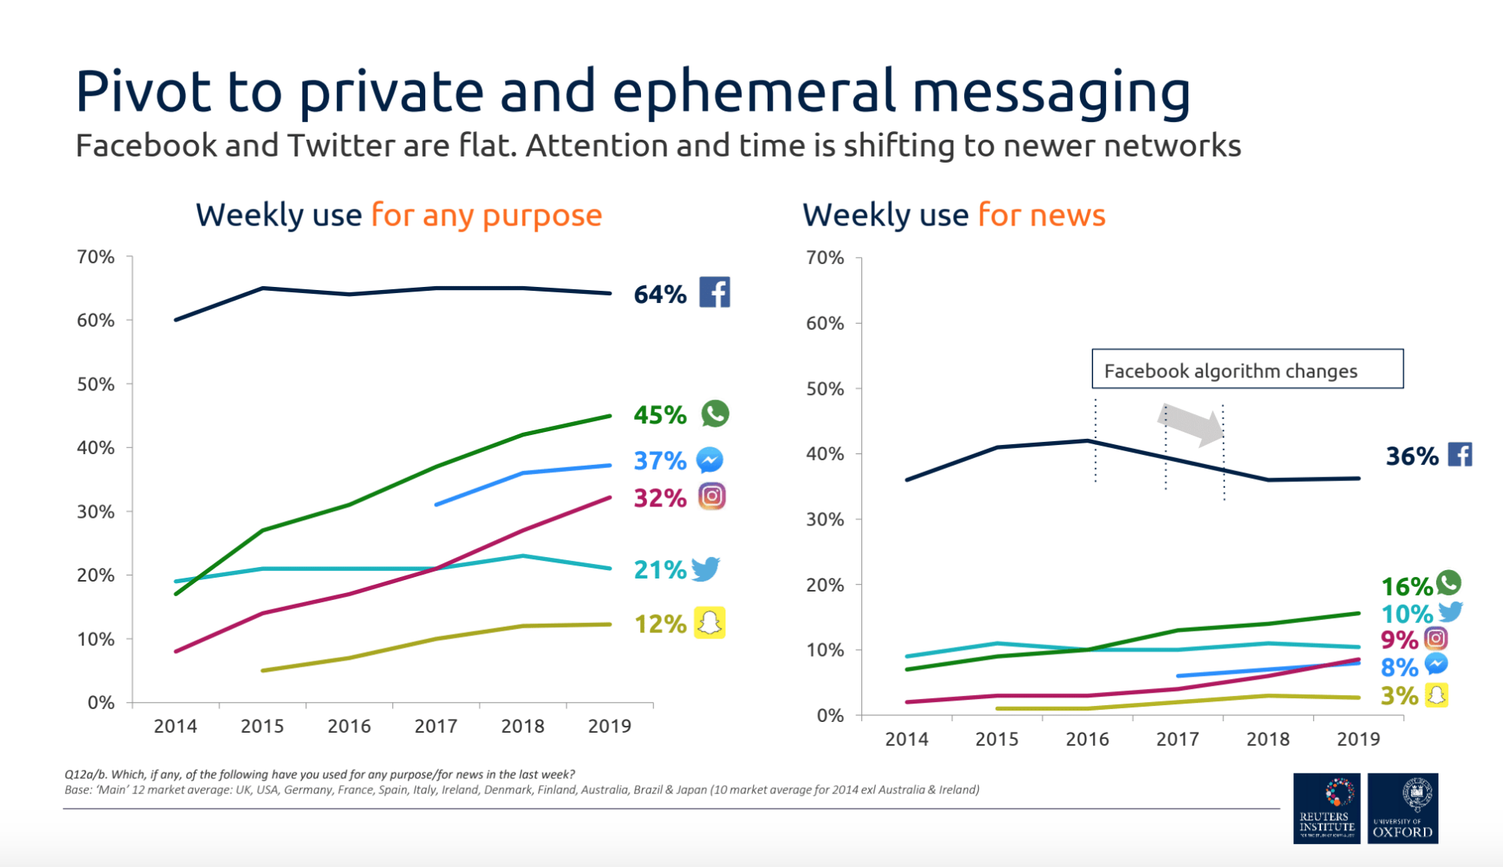
Filter bubbles

Slide 48
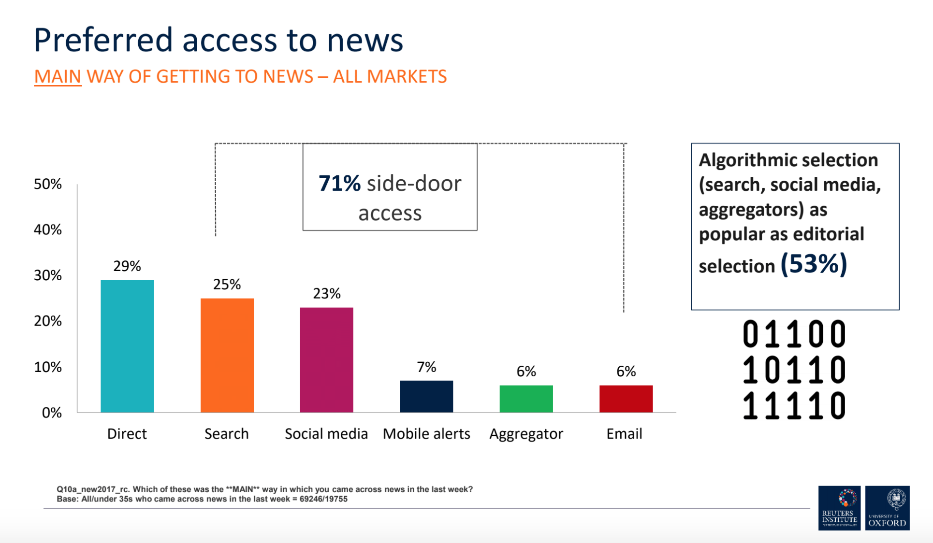
Filter bubbles
Notes:
So when it comes to filter bubbles, it's clear that the potential is there for us to be concerned. It's clear that algorithms and algorithmically driven services are very important, and a lot of people are using them to get news online.

Slide 49
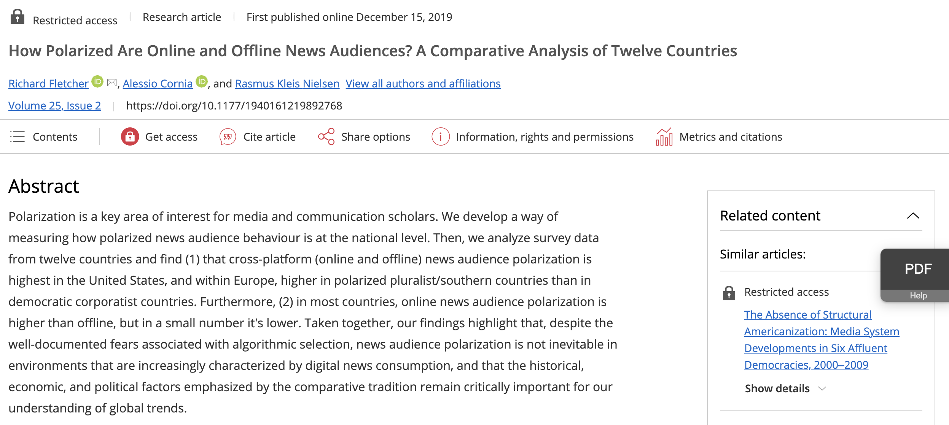
Filter bubbles
Notes:
What we found was that the more people use direct access, the less diverse their news diet was. Not only people are using more sources of news when they get their news on social media. They're using lots of different sources, and the balance between those different sources improves with respect to diversity
What we found is that a process of automated serendipity effectively diversifies people's news diets. People who use search engines for news on average use more news sources than people who don't. More importantly, they're more likely to use sources from both the left and the right.
Most of the best available independent empirical evidence seems to suggest that online news use on search and social media is more diverse. But there's a possibility that this diversity is causing some kind of polarisation, in both attitudes and usage. This is interesting, because in some ways it's the opposite of what the filter bubble hypothesis predicted.

Slide 50
Filter bubbles
The more people use direct access, the less diverse their news diet was. Not only people are using more sources of news when they get their news on social media. They're using lots of different sources, and the balance between those different sources improves with respect to diversity
What we found is that a process of automated serendipity effectively diversifies people's news diets. People who use search engines for news on average use more news sources than people who don't. More importantly, they're more likely to use sources from both the left and the right.
Most of the best available independent empirical evidence seems to suggest that online news use on search and social media is more diverse. But there's a possibility that this diversity is causing some kind of polarisation, in both attitudes and usage. This is interesting, because in some ways it's the opposite of what the filter bubble hypothesis predicted.

Slide 51
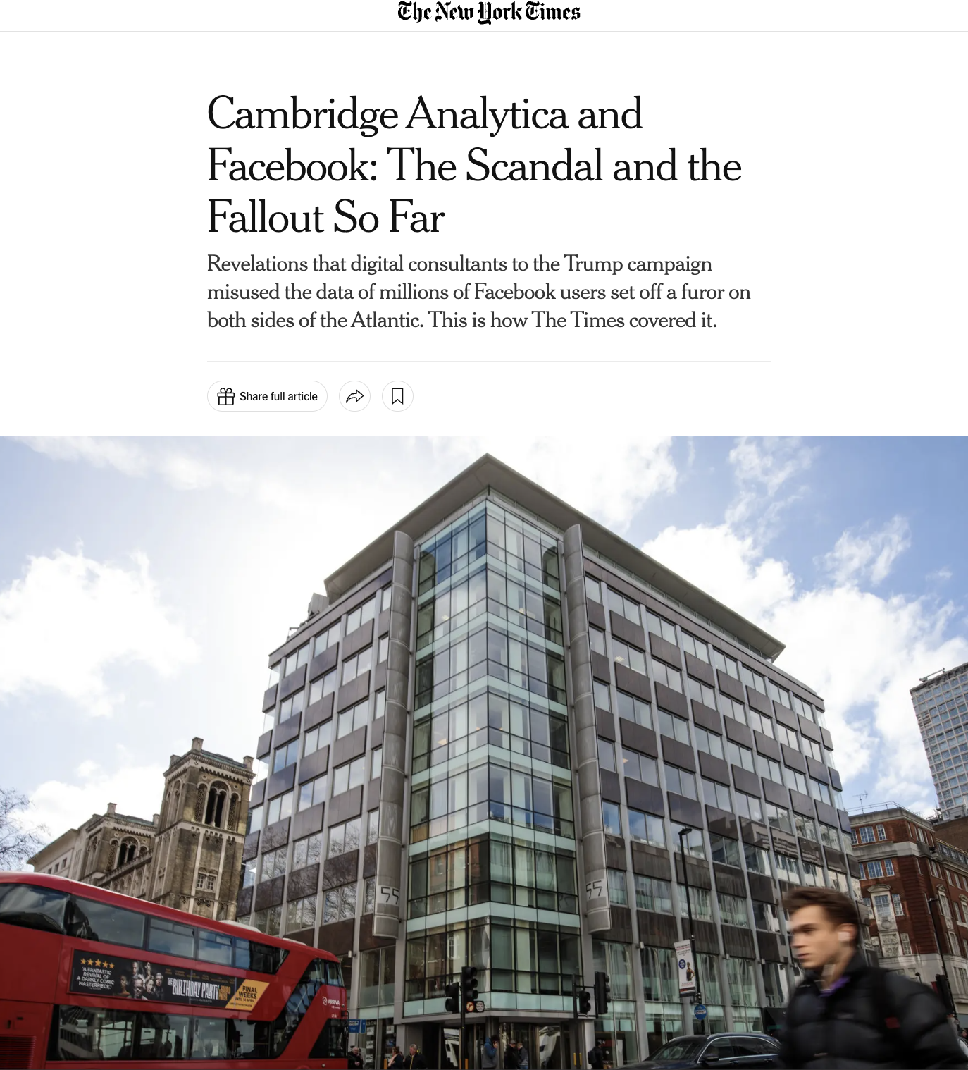
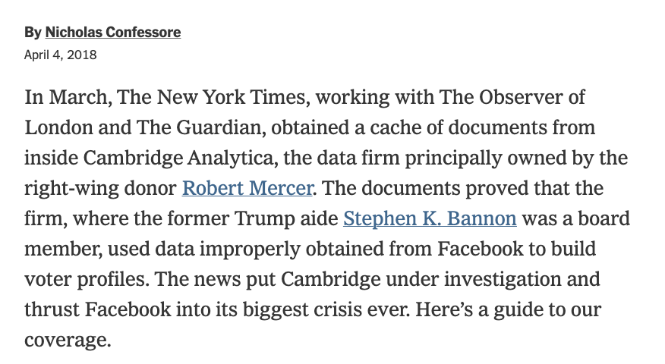
Platform beat

Slide 52
Platform beat
“The platform beat is a vital component of journalism – Holding platforms accountable for their actions, inactions and design choices.
News organizations and digital platforms intertwine in ways that generate challenges for journalism’s watchdog function.
Platform beat involves journalistic oversight of institutions that are simultaneously (and, somewhat ironically) one of the most significant distributors of journalism.

Slide 53
Platform beat
Evolving foundation of interdependence between news organizations and digital platforms.
According to recent research, Google and Facebook’s publicly disclosed contributions to journalism total over $700 million since 2016 (Usher, 2020). Google’s Digital News Innovation Fund has donated over 140 million euros to news organizations across Europe since its launch in 2015
Unlike advertisers, digital platforms’ governance decisions can dramatically and instantaneously affect the distribution of journalism

Slide 54
Platform Responsability
To what extent should social media platforms be responsible for preventing the spread of disinformation? Should they play a more active role in content moderation, and what implications might this have for free speech?
How can journalists balance the need for quick news dissemination on digital platforms with the imperative to verify information thoroughly? What challenges does this pose to journalistic integrity?
Notes:
To what extent should social media platforms be responsible for preventing the spread of disinformation? Should they play a more active role in content moderation, and what implications might this have for free speech?
How can journalists balance the need for quick news dissemination on digital platforms with the imperative to verify information thoroughly? What challenges does this pose to journalistic integrity?

Slide 55
Platforms affordances
Devices are not mere tools: they are also complex and unstable arrangements that bring together various people and objects with particular purposes.
Affordances characterize the actions that are suggested by an object or an environment. – Relationship between the technical and the social.
How the material qualities of technologies suggest certain practices while they also accommodate (un)intended uses.
Notes:
Things build to be naturally, almost physiologically intuitive.
Extend beyond our physiological understanding
Everywhere where from implies function

Slide 56
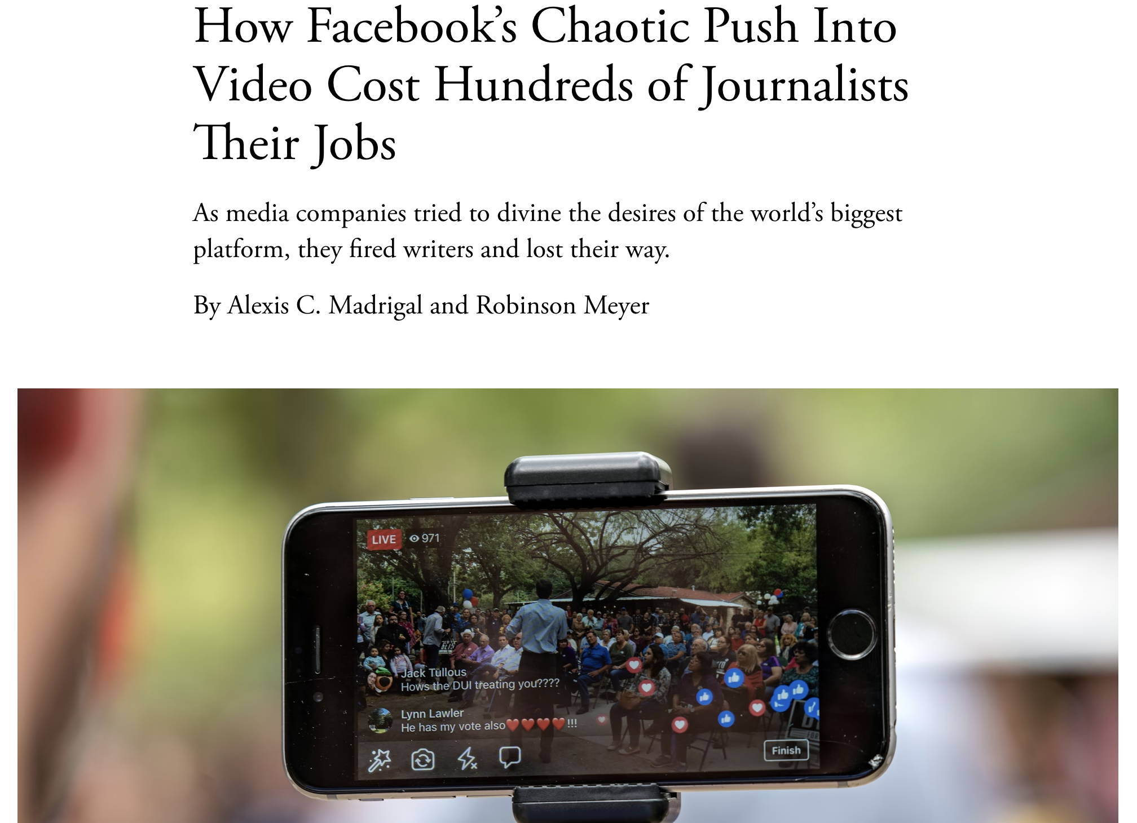
Platforms dependencies
As media companies desperately tried to do what Facebook wanted, many made the disastrous decision to “pivot to video,” laying off reporters and editors by the dozen. And when views plunged and video’s poor return on investment became more apparent, some companies pivoted back, firing video producers by the dozens.

Slide 57
Volume of Data
The sheer volume of data on digital platforms makes it challenging for journalists to manually verify every piece of information, especially when dealing with millions of data points.
Given the overwhelming volume of data on digital platforms, what strategies can journalists employ to prioritize information for verification without sacrificing accuracy?
Notes:
Explanation: The sheer volume of data on digital platforms makes it challenging for journalists to manually verify every piece of information, especially when dealing with millions of data points.
Given the overwhelming volume of data on digital platforms, what strategies can journalists employ to prioritize information for verification without sacrificing accuracy?

Slide 58
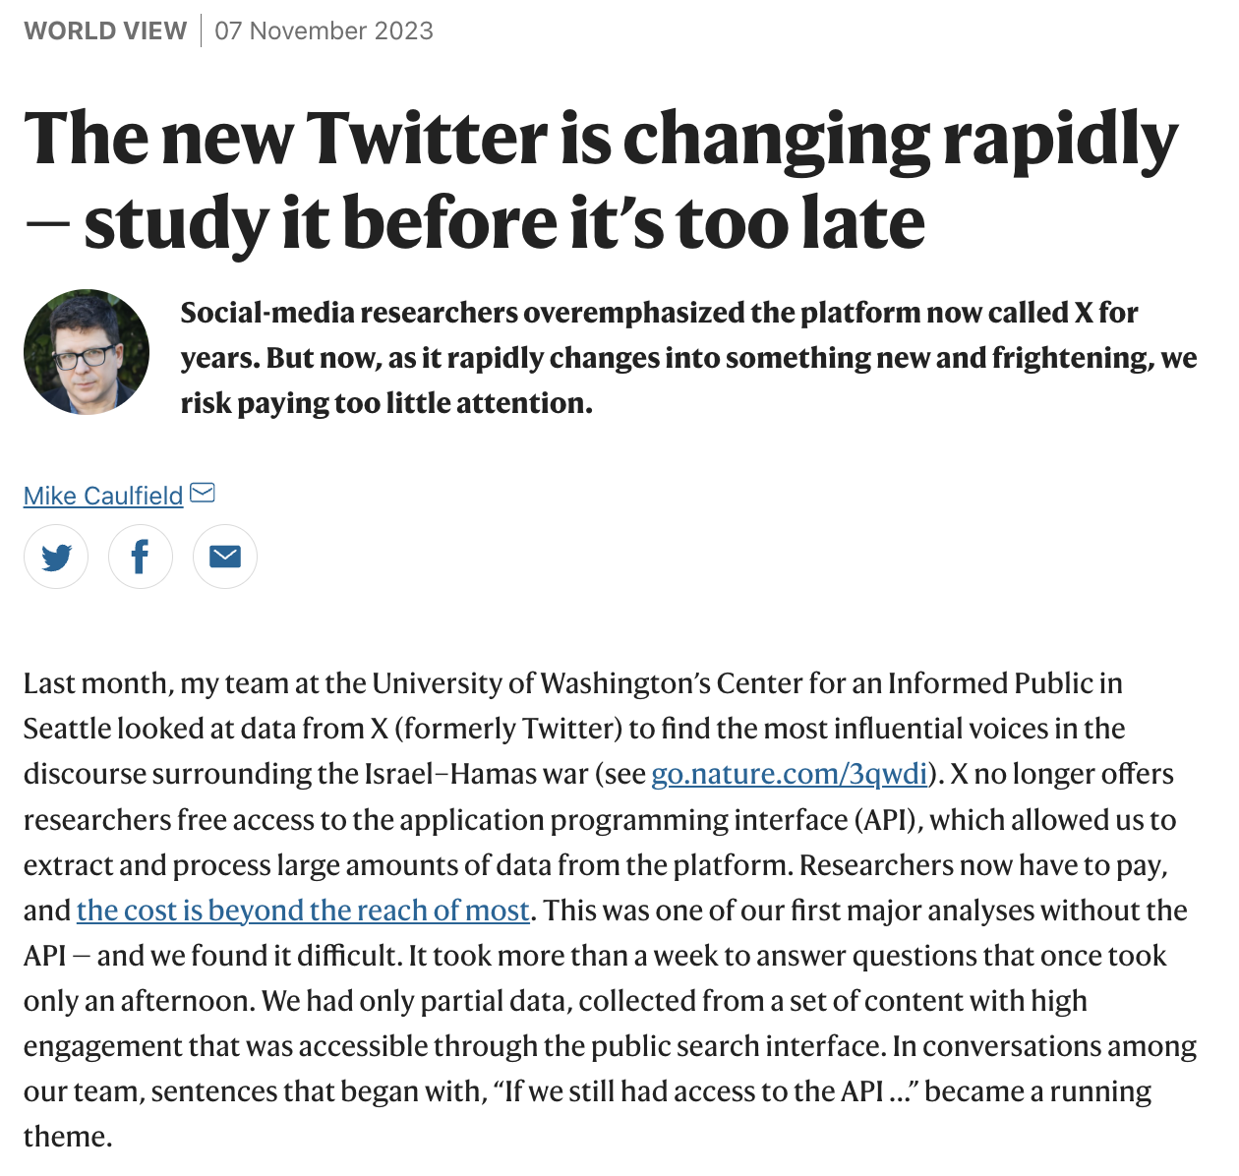
Post API
Notes:
Limited Data Access:
Explanation: Digital platforms may restrict access to certain data, hindering journalists' ability to thoroughly investigate and corroborate information.
In cases where digital platforms limit access to data, how can journalists advocate for greater transparency without compromising user privacy or platform security?
APIs are mechanisms that enable two software components to communicate with each other using a set of definitions and protocols. For example, the weather bureau's software system contains daily weather data. The weather app on your phone “talks” to this system via APIs and shows you daily weather updates on your phone.

Slide 59
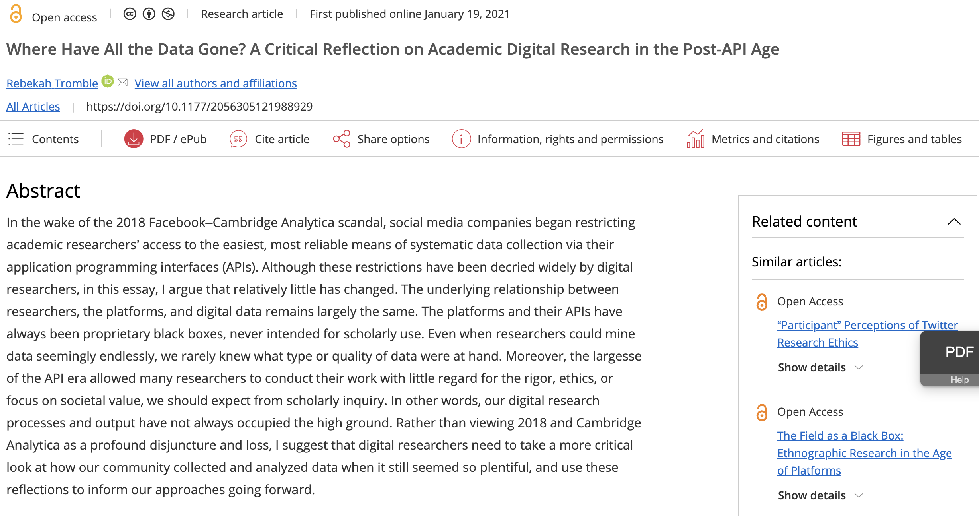
Post API
Notes:
Limited Data Access:
Explanation: Digital platforms may restrict access to certain data, hindering journalists' ability to thoroughly investigate and corroborate information.
In cases where digital platforms limit access to data, how can journalists advocate for greater transparency without compromising user privacy or platform security?
APIs are mechanisms that enable two software components to communicate with each other using a set of definitions and protocols. For example, the weather bureau's software system contains daily weather data. The weather app on your phone “talks” to this system via APIs and shows you daily weather updates on your phone.

Slide 60


The Elephant in the (News)Room

Slide 61
Today exercise
Pick one social media platform.
Identify the opportunities and challenges that it could bring to your newsroom.
How would you convince your editor NOT to invest in using that platform?

Slide 62
Social Media
Tomás Dodds | Leiden

